Slide 1



Green Skills – 1.3 Green Skills for Sustainable Development
Bridging the Green & Digital Divide
Enhance the quality of vocational education and training (VET) in the Western Balkans for sustainable development.

Slide 2


Learning outcomes
Identify essential green skills relevant to different sectors of the labour market.
Explain the importance of green skills for sustainable development and the twin transition.
Integrate green skills into vocational training programs and classroom practices.
Use case studies to demonstrate successful applications of green skills in the workforce.
Develop teaching strategies that increase students’ awareness, motivation, and confidence in applying green skills.

Slide 3
Course overview
Module 1: Identifying essential green skills across the labour market
Subtitle 1.1: Defining green skills
Module 2: Integrating green skills into vocational training
Subtitle 2.1: Curriculum integration, teaching approaches and methodologies
Module 3: Case studies – successful green skill applications in the workforce
Subtitle 1.2: Labor market trends and demands, green skills in the Western Balkans
Subtitle 1.3: Educators’ role in skill identification
Subtitle 2.2: Synergies between green and digital skills
Subtitle 2.3: Overcoming barriers
Subtitle 3.1: Emerging green jobs in energy efficiency, waste management, recycling, renewable energy, and sustainable production
Subtitle 3.2: Sectoral case studies
Subtitle 3.3: Student projects for applied learning

Slide 4
Module 1: Identifying essential green skills across the labour market
Subtitle 1.1: Defining green skills
Subtitle 1.2: Labor market trends and demands, green skills in the Western Balkans
Subtitle 1.3: Educators’ role in skill identification
Bridging the Green & Digital Divide
Enhance the quality of vocational education and training (VET) in the Western Balkans for sustainable development.

Slide 5
Subtitle 1.1: Defining green skills
Key aspects:
The European Sustainability Competence Framework (GreenComp)
Notes:
Question : do you already have ideas on your abstract subject ?
Prefer meeting before (OCs to brainstorm+each with subjects) or during CM ?

Slide 6
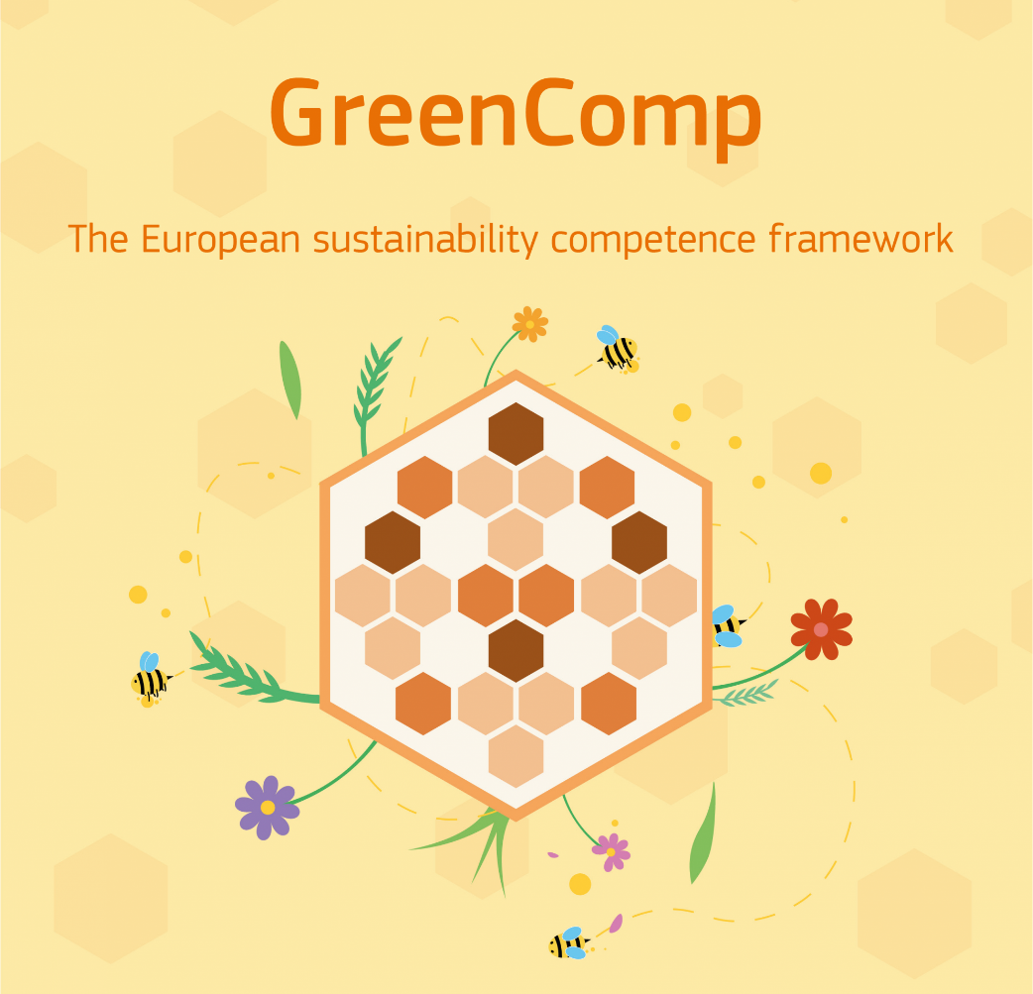
The European Sustainability Competence Framework (GreenComp)
defines essential competences for sustainability
12 key competences into four overarching areas
explores each area and its associated competences in detail
Images by European Union/ The Joint Research Centre - GreenComp

Slide 7
The European Sustainability Competence Framework (GreenComp)
Images by European Union/ The Joint Research Centre - GreenComp

Slide 8
Subtitle 1.2: Labor market trends and demands, green skills in the Western Balkans
Key aspects:
The European Skills Agenda and Cedefop
Labour market trends and demands
Notes:
Question : do you already have ideas on your abstract subject ?
Prefer meeting before (OCs to brainstorm+each with subjects) or during CM ?

Slide 9
The European Skills Agenda and Cedefop
European Skills Agenda – EU strategy to equip people with the skills needed for digitalisation and the green transition, focusing on upskilling, reskilling, aligning education with labour market needs, and preventing skills shortages that could slow competitiveness or the green transition.
Cedefop – EU’s agency focusing on vocational education and training (VET) and skills intelligence, providing forecasts and labour-market analysis (e.g., Digital, Greener and More Resilient (2021); Skills in Transition: The Way to 2035 (2023)), highlighting how green and digital transitions reshape skills demand and guiding policy through initiatives such as the Pact for Skills.

Slide 10
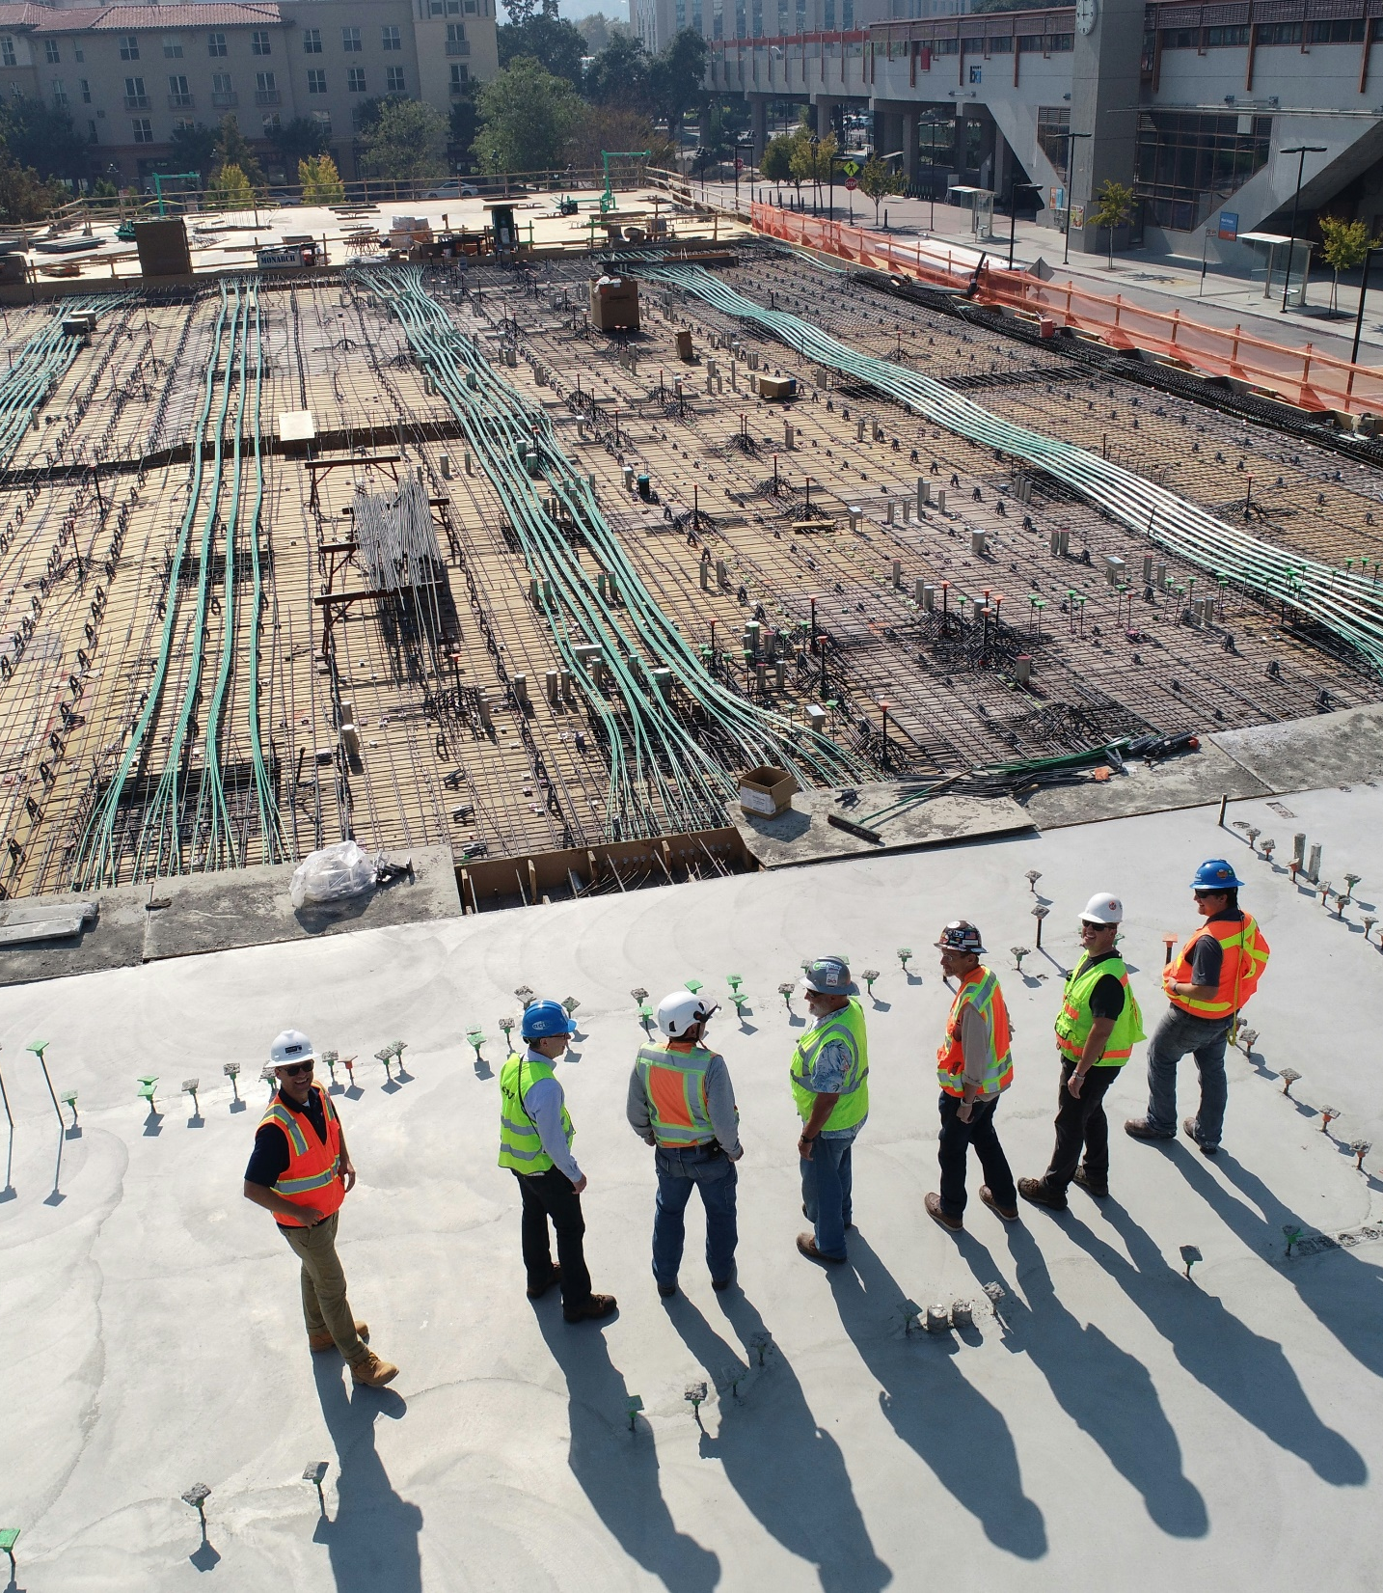
Labour market trends and demands
Rising demand for green skills – about 40% of EU job ads require medium or high green-transition skills, vacancy rates are increasing, and the EU expects a need for 130,000–145,000 additional skilled workers by 2030.
Sectoral and occupational shifts – green and digital transitions are reshaping jobs, increasing demand for science and engineering professionals, technical trades, and workers in construction, energy, waste management, and R&D.
Growing skills gaps and shortages – vacancies in key sectors have doubled, with shortages in plumbers, electricians, building trades, and drivers, plus rising demand for combined technical, digital, and environmental skills.
Image by scott-blake-x-ghf9LjrVg-unsplash

Slide 11

Labour market trends and demands
Implications for policy and training- The European Skills Agenda highlights the need for stronger skills to support the green and digital transitions, as SMEs face major talent shortages and renewable energy sectors may create up to 3.5 million new jobs by 2030.
Western Balkans challenges and needs – High youth unemployment and weak alignment between VET and labour market needs leave young people unprepared, while demand for green and digital skills grows rapidly in Kosovo and Bosnia and Herzegovina.
Image by brooke-cagle--uHVRvDr7pg-unsplash

Slide 12
Subtitle 1.3: Educators’ role in skill identification
Key aspects:
Educators and green skills
Identifying and strengthening competences
Notes:
Question : do you already have ideas on your abstract subject ?
Prefer meeting before (OCs to brainstorm+each with subjects) or during CM ?

Slide 13
Educators and green skills
Educators develop green skills by identifying competences, tracking trends, and adapting curricula to labour market needs.
GreenComp provides a 12-competence framework across values, complexity, futures thinking, and action.
Educators map learners’ competences, identify gaps, and support self- and peer-assessment.

Slide 14
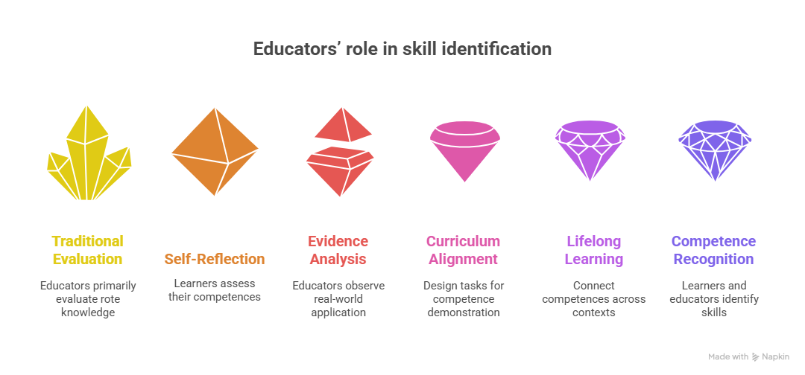
Identifying and strengthening competences
Educators observe learners in real tasks to assess application of competences like systems thinking and collective action.
Learning activities and projects allow learners to demonstrate full-range competences.
GreenComp guides curriculum updates, professional development, and integration of skill identification.
Educators help learners connect competences from formal and informal experiences, supporting lifelong learning.

Slide 15
Module 2: Integrating green skills into vocational training
Subtitle 2.1: Curriculum integration, teaching approaches and methodologies
Subtitle 2.2: Synergies between green and digital skills
Subtitle 2.3: Overcoming barriers
Bridging the Green & Digital Divide
Enhance the quality of vocational education and training (VET) in the Western Balkans for sustainable development.

Slide 16
Subtitle 2.1: Curriculum integration, teaching approaches and methodologies
Key aspects:
Curriculum integration for sustainability
Learner-centred and experiential teaching
Implementation and support
Notes:
Question : do you already have ideas on your abstract subject ?
Prefer meeting before (OCs to brainstorm+each with subjects) or during CM ?

Slide 17
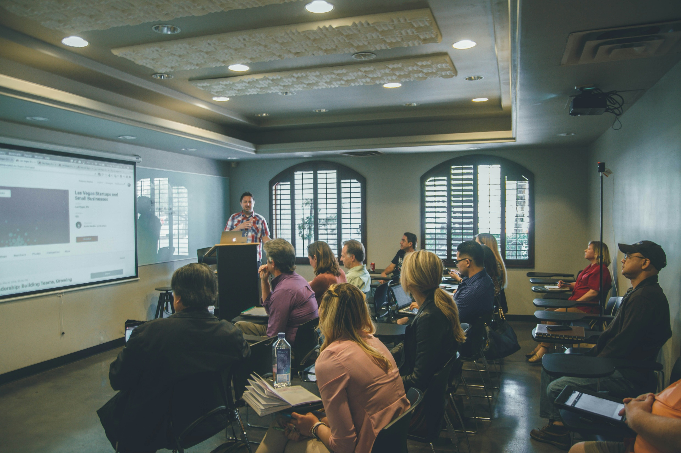
Curriculum integration for sustainability
Integrating knowledge, skills, and attitudes across subjects ensures learners engage with sustainability holistically.
GreenComp defines 12 competences in four areas: sustainability values, complexity, futures thinking, and action, applicable in formal, non-formal, and informal learning.
Cedefop highlights learning-outcomes-based curricula: design education around what learners will know, do, and understand.
Image by kenny-eliason-1-aA2Fadydc-unsplash

Slide 18

Learner-centred and experiential teaching
Sustainability competences should be embedded across subjects, e.g., systems thinking in science, futures thinking in social studies, collective action in projects.
Learner-centred approaches like project-based learning, peer learning, and reflection foster real-world competence.
Assessments focus on demonstrating competences via portfolios, projects, presentations, and peer evaluation rather than memorization.
Image by element5-digital-OyCl7Y4y0Bk-unsplash

Slide 19

Implementation and support
Effective integration requires teacher expertise, interdisciplinary planning, and institutional resources.
Curriculum and teaching should be iterative, adapting to evolving sustainability challenges.
Combined, GreenComp provides the competence framework, and Cedefop guides curriculum design, teaching, and assessment to achieve meaningful learning outcomes.
Image by jaredd-craig-HH4WBGNyltc-unsplash

Slide 20
Subtitle 2.2: Synergies between green and digital skills
Key aspects:
GreenComp and DigCompEdu framework
Green and digital skills
Notes:
Question : do you already have ideas on your abstract subject ?
Prefer meeting before (OCs to brainstorm+each with subjects) or during CM ?

Slide 21
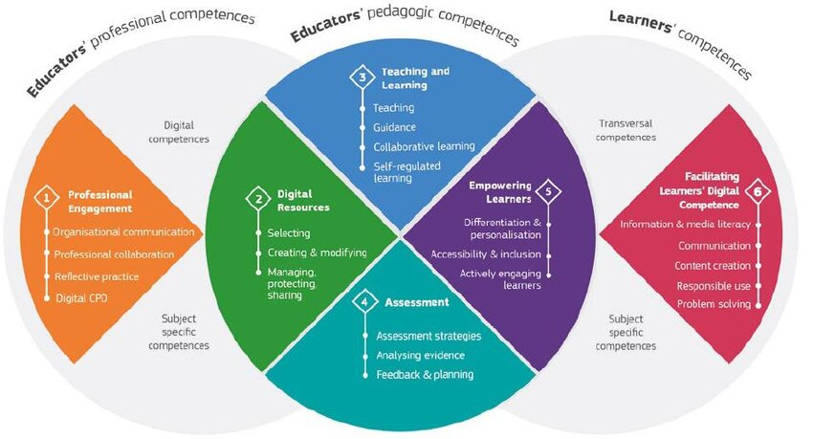
The European Union's DigComp framework for digital competence
Images by European Union/ The Joint Research Centre - DigiComp

Slide 22
The European Sustainability Competence Framework (GreenComp)
Images by European Union/ The Joint Research Centre - GreenComp

Slide 23

Green and digital skills
Twin transition – aquiring green and digital skills prepares learners for future-ready careers, enabling use of technologies like AI, IoT, and smart energy systems for sustainable solutions.
Curriculum integration – embedding GreenComp and DigComp skills in projects (e.g., smart factories, renewable energy monitoring, e-mobility) develops critical thinking, problem-solving, and interdisciplinary collaboration.
Employability and innovation – learners gain digital literacy and sustainability mindset, meeting employer demand for professionals who use technology responsibly to achieve environmental and social goals.
Image by round-icons-IeIwD2EB1hw-unsplash

Slide 24
Subtitle 2.3: Overcoming barriers
Key aspects:
Using digital tools to address limited materials
Supporting teacher training and professional development
Correcting student misconceptions through interactive learning
Practical applications across key sustainability themes
Leveraging EU-Funded projects for solutions
Notes:
Question : do you already have ideas on your abstract subject ?
Prefer meeting before (OCs to brainstorm+each with subjects) or during CM ?

Slide 25

Using digital tools to address limited materials
Lack of up-to-date sustainability resources in VET is a common challenge.
Digital platforms, OERs, virtual labs, and simulations allow learners to explore energy efficiency, recycling, and renewable energy without costly equipment.
EU initiatives like Erasmus+ provide freely available, customizable teaching packages aligned with industry standards.
Image by szabo-viktor-A_VdqtHsNsU-unsplash

Slide 26

Supporting teacher training and professional development
Many VET educators need stronger knowledge and confidence in sustainability and digital pedagogy.
Digital tools support online courses, webinars, LMS tracking, and collaborative teacher communities.
Virtual workshops provide hands-on experience, enabling peer mentoring and continuous improvement.
Image by headway-5QgIuuBxKwM-unsplash

Slide 27

Correcting student misconceptions through interactive learning
Students may have false assumptions about waste, energy, and renewable systems.
Virtual experiments, AR experiences, and gamified modules make abstract concepts tangible.
Interactive learning encourages critical thinking, responsible behaviors, and deeper understanding of sustainability.
Image by tim-mossholder-WE_Kv_ZB1l0-unsplash

Slide 28

Practical applications across key sustainability themes
Energy efficiency - dashboards track and optimize simulated energy use.
Waste management and recycling - virtual labs simulate sorting and impact analysis.
Renewable energy - platforms model solar, wind, and hydro systems.
Sustainable production - simulations highlight eco-friendly manufacturing and resource planning.
Image by erone-stuff-Iv-SnVK3tQc-unsplash

Slide 29

Leveraging EU-Funded projects for solutions
Erasmus+, ECOTRAIN, GreenHive, and EPALE provide interactive modules, guides, and assessment tools.
Resources support curriculum integration, teacher capacity building, and project-based learning.
Using EU tools helps VET institutions fill content gaps, enhance digital and sustainability skills, and prepare environmentally responsible graduates.
Image by guillaume-perigois-0NRkVddA2fw-unsplash

Slide 30
Module 3: Case studies – successful green skill applications in the workforce
Subtitle 3.1: Emerging green jobs in energy efficiency, waste management, recycling, renewable energy, and sustainable production
Subtitle 3.2: Sectoral case studies in energy efficiency, waste management, recycling, renewable energy, and sustainable production
Subtitle 3.3: Student projects for applied learning
Bridging the Green & Digital Divide
Enhance the quality of vocational education and training (VET) in the Western Balkans for sustainable development.

Slide 31
Subtitle 3.1: Emerging green jobs
Key aspects:
Energy efficiency
Waste management
Recycling
Renewable energy
Sustainable production
Notes:
Question : do you already have ideas on your abstract subject ?
Prefer meeting before (OCs to brainstorm+each with subjects) or during CM ?

Slide 32
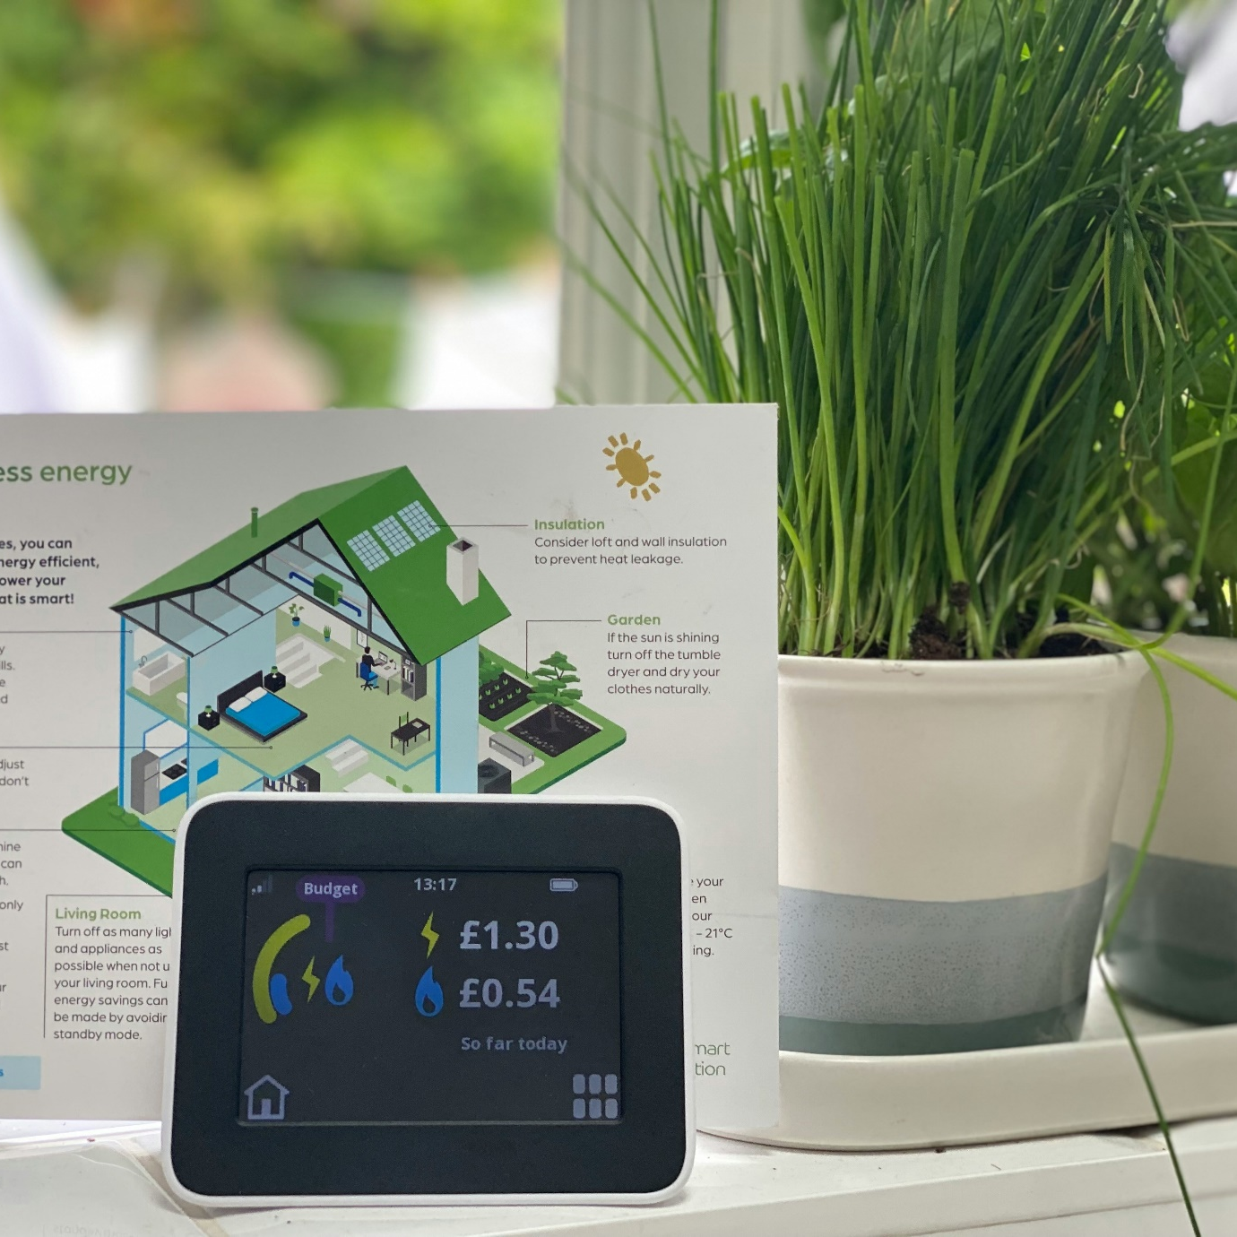
Energy efficiency
Energy auditor - assesses buildings or industrial processes to identify energy-saving opportunities.
Building retrofit specialist - modifies existing buildings to improve their energy efficiency, sustainability, and performance
Smart energy system operator - manages digital energy monitoring and control systems.
HVAC efficiency technician - installs, maintains, and repairs heating, ventilation, and air conditioning systems with a focus on optimizing their performance and reducing energy consumption
Image by sian-wynn-jones-YTG6kkQweck-unsplash

Slide 33
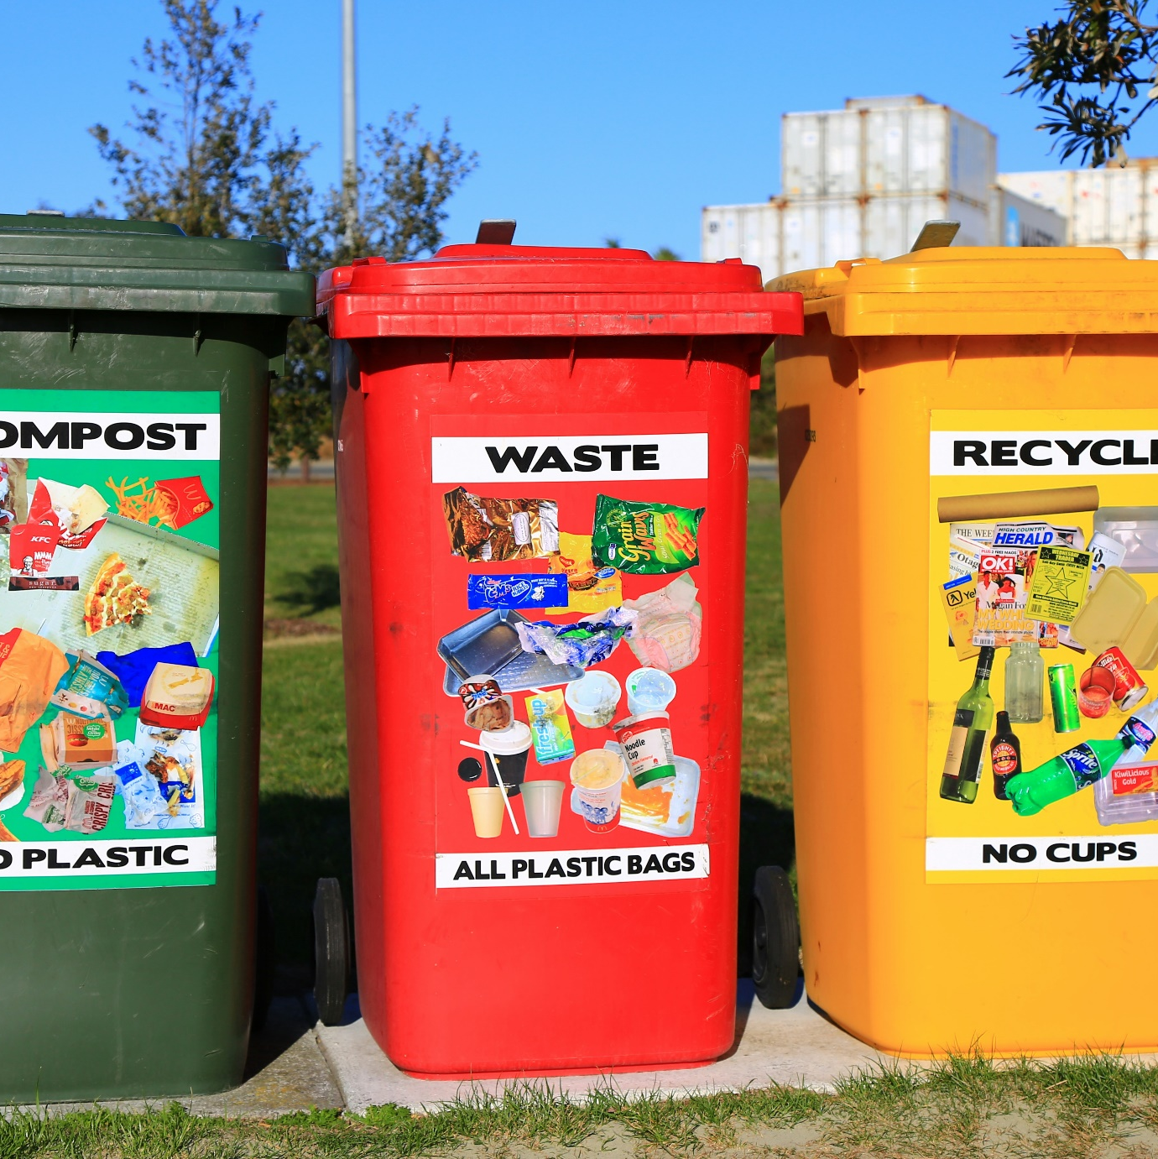
Waste management
Waste collection coordinator - organizes and optimizes waste collection processes.
Hazardous waste technician - handles dangerous or toxic materials safely.
Composting and biowaste specialist - manages organic waste and biogas production.
Image by nareeta-martin-FoG7PKNYjpM-unsplash

Slide 34

Recycling
Recycling plant operator - oversees processing of recyclable materials.
Material recovery specialist - identifies, sorts, and recovers valuable materials.
Upcycling designer -creates new products from waste materials.
Circular economy consultant - advises companies on implementing circular strategies.
Image by alfonso-navarro-qph7tJfcDys-unsplash

Slide 35
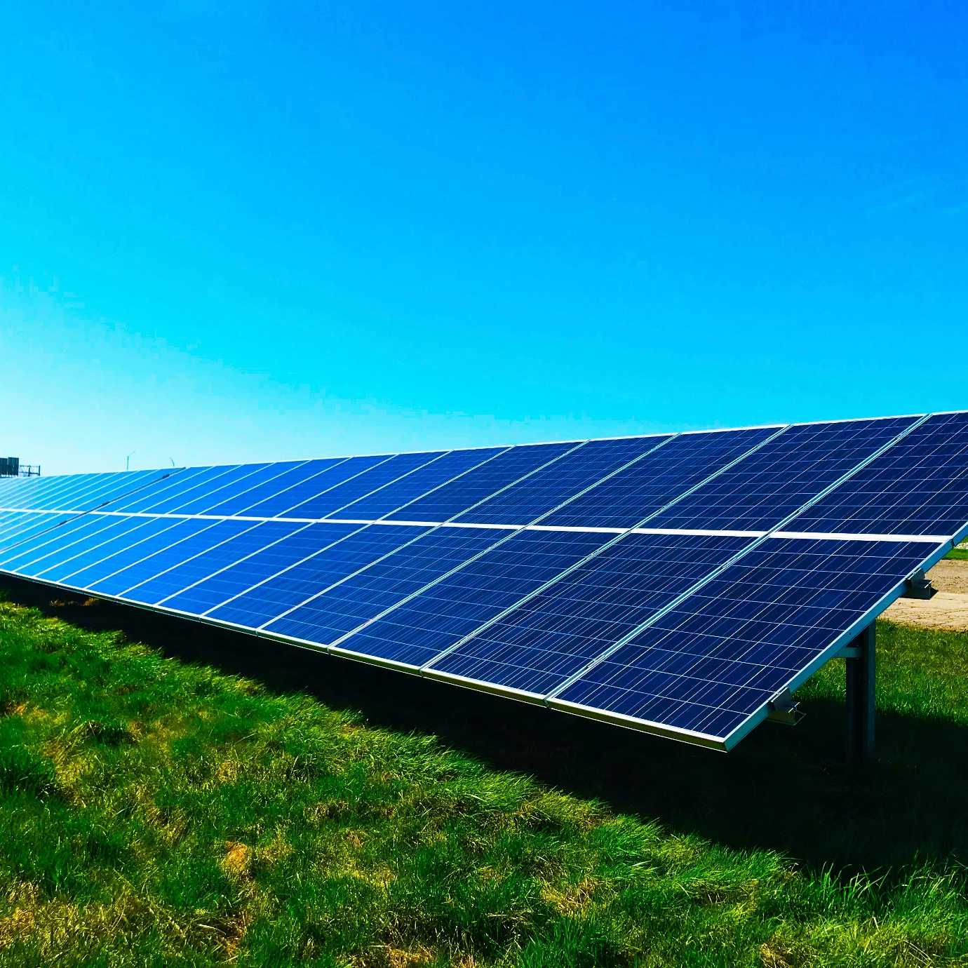
Renewable energy
Solar photovoltaic installer - installs and maintains solar panels.
Wind turbine technician - operates and maintains wind turbines.
Bioenergy engineer - designs and manages bioenergy systems.
Energy storage specialist - implements battery and storage solutions.
Image by chelsea-WvusC5M-TM8-unsplash

Slide 36
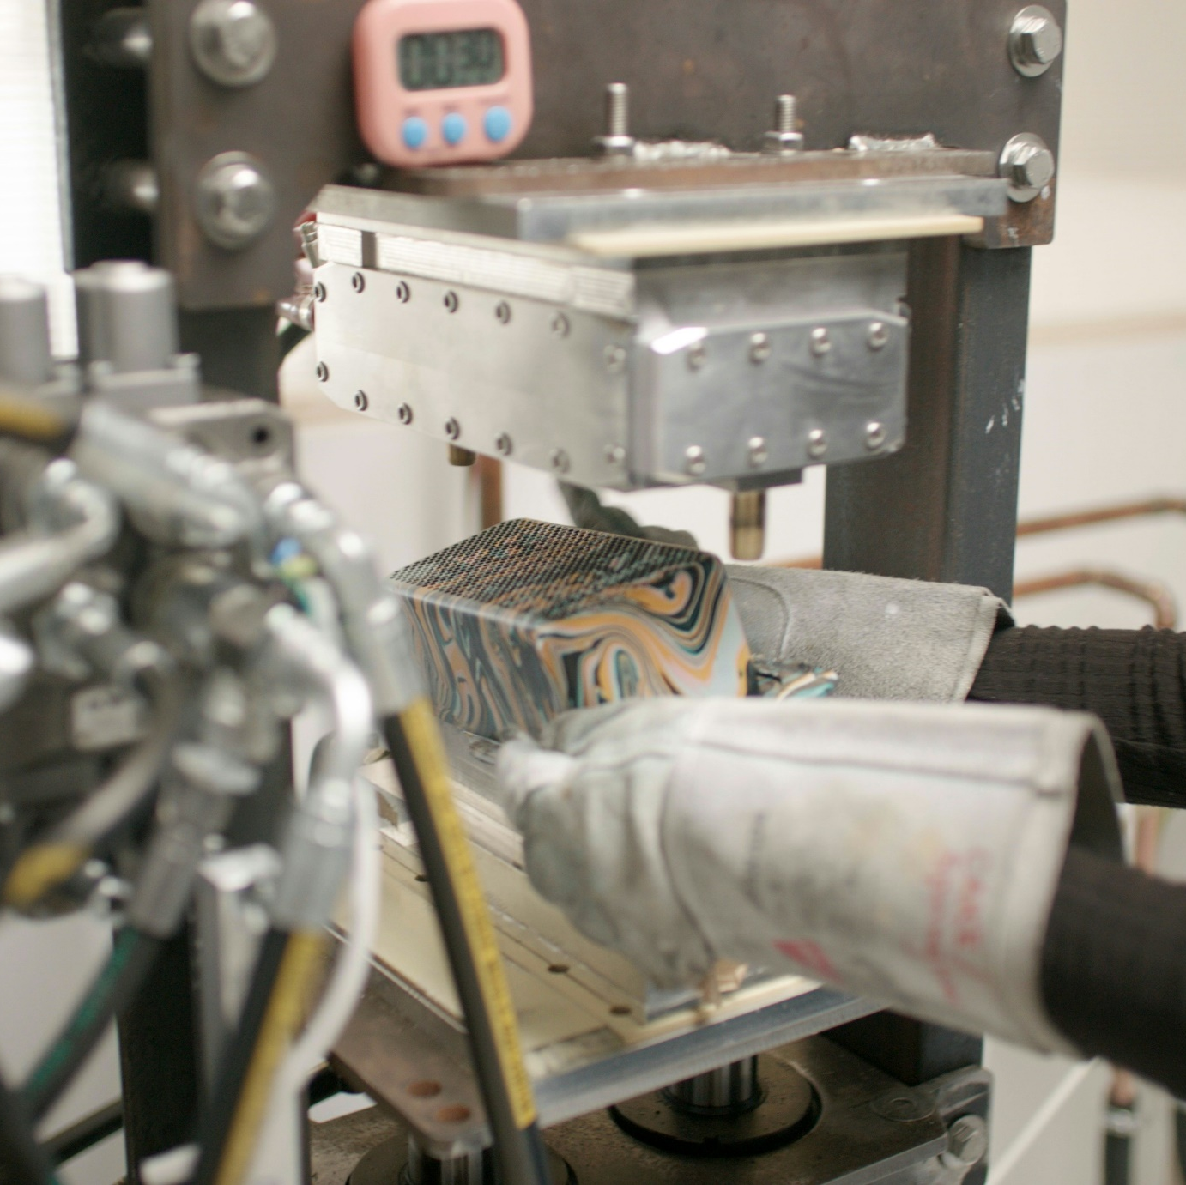
Sustainable production
Green supply chain manager - optimizes sourcing, production, and logistics sustainably.
Eco-design engineer - designs products with minimal environmental impact.
Sustainable materials specialist - develops and selects eco-friendly materials.
Life-cycle assessment analyst - valuates environmental impacts of products or processes.
Image by gomi-DS-SEvTKdpA-unsplash

Slide 37
Subtitle 3.2: Sectoral case studies
Key aspects:
Energy efficiency
Waste management
Recycling
Renewable energy
Sustainable production
Notes:
Question : do you already have ideas on your abstract subject ?
Prefer meeting before (OCs to brainstorm+each with subjects) or during CM ?

Slide 38
Waste management and energy efficiency
  Sector: Waste management – FoodObox
  Connects consumers with surplus edible food via discounted “surprise boxes”
  Reduces food waste and promotes circular resource use.
  Each box prevents waste and avoids around 2.5 kg of CO₂ emissions.
  Sector: Energy Efficiency – Schneider Electric
  Uses IoT-enabled smart building systems to optimize energy use in real time.
  Reduces electricity consumption, operational costs, and carbon emissions.
  “EcoStruxure Building Advisor” identifies inefficiencies and recommends improvements.

Slide 39
Recycling, renewable energy
and sustainable production
  Sector: Recycling – TerraCycle
  Collects and transforms hard-to-recycle waste (packaging, electronics, consumer products).
  “Loop” program provides reusable, refillable packaging to reduce landfill waste.
  Supports circular economy by closing material loops and conserving resources.
  Sector: Renewable energy – Vestas
  Designs, manufactures, and services wind turbines with advanced monitoring systems.
  Drives decarbonization by expanding global wind energy production.
  Supports local communities through job creation and educational programs.
  Sector: Sustainable production – Kronospan
  Uses responsibly sourced wood with strict traceability and sustainable forestry standards.
  Recycles production waste (sawdust, offcuts, shavings) and uses it for new products or energy generation.
  Improves efficiency with energy-saving machinery and process optimization, reducing emissions and costs.

Slide 40
Subtitle 3.3: Student projects for applied learning
Key aspects:
Student projects for applied learning
Examples
Notes:
Question : do you already have ideas on your abstract subject ?
Prefer meeting before (OCs to brainstorm+each with subjects) or during CM ?

Slide 41

Student projects for applied learning
Hands-on projects that let students apply academic knowledge and skills to real-world situations.
Foster critical thinking, creativity, and problem-solving through authentic, career-focused tasks (e.g., internships, community initiatives, research projects).
Build practical experience, teamwork, and professional competencies relevant to future careers.
Image by kotak-kanan-bkrKpCnSBzc-unsplash

Slide 42
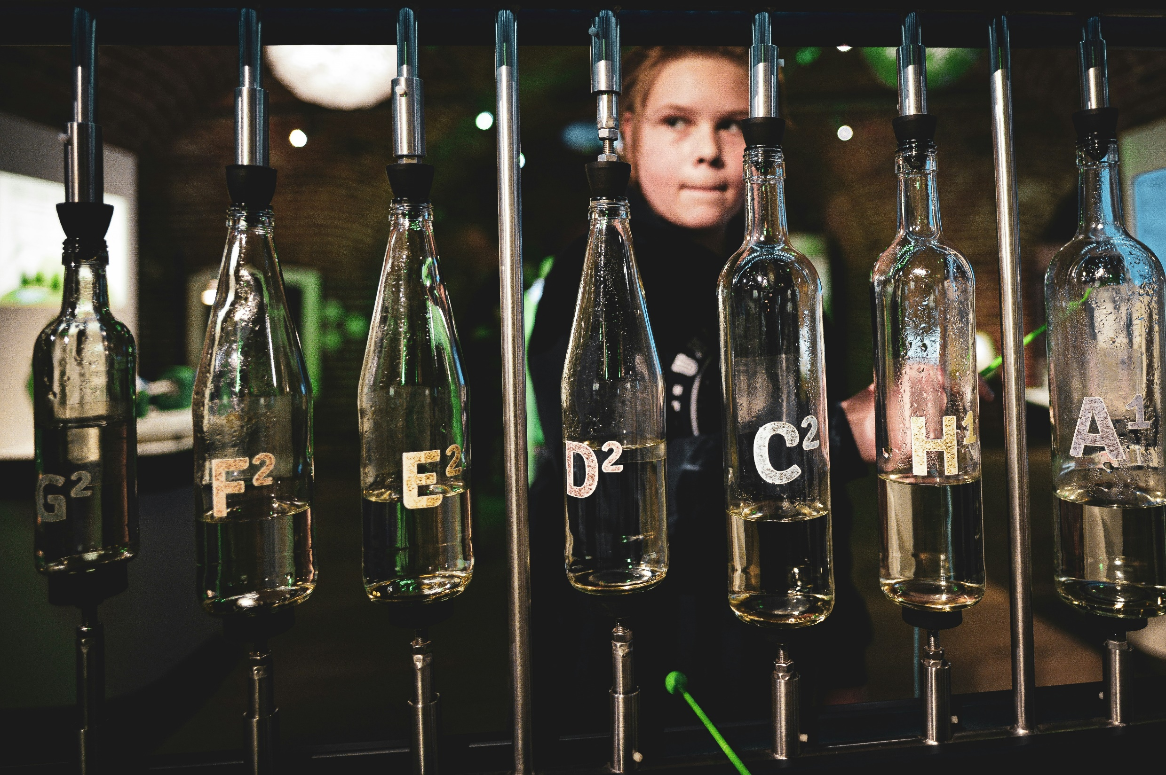
Examples
Use real-world case studies or local challenges from specific sectors or regions to create meaningful, applied learning projects.
Assign students tasks such as analysing the situation, identifying problems, and proposing practical, workable solutions.
Encourage exploration of circular economy strategies like how resources are reused, recycled, or repurposed and opportunities to close material loops.
Image by gabriela-SCiwe1FASQQ-unsplash

Slide 43
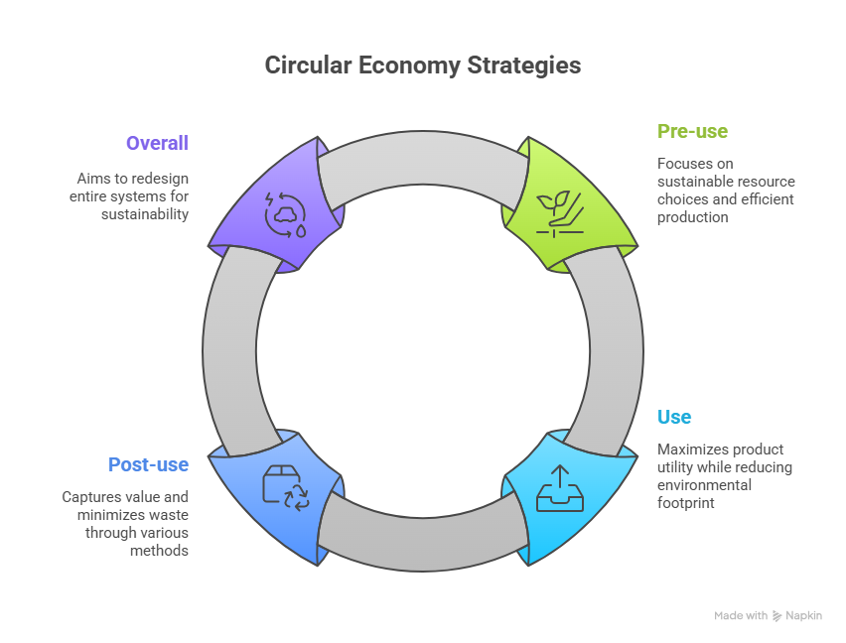
Circular economy strategies to be embedded
Pre-use - choose circular materials, optimize sourcing, sustainable manufacturing, durable product design, and eco-friendly packaging & logistics.
Use - implement product-as-a-service, sharing models, modularity, and maintenance programs to extend product life and efficiency.
Post-use - refill, reuse, resell, refurbish, remake, recover, and recycle to capture value and minimize waste.
Overall - reinvent systems by integrating circular strategies across all stages to reduce resource consumption and promote sustainable production.

Slide 44
Reflective activity
Which green skills (e.g., energy efficiency, waste reduction, systems thinking, digital monitoring) are most relevant to your learners’ future careers? How are these skills currently taught or addressed in your lessons or workplace? Where do you notice gaps or opportunities for improvement? How could you update your curriculum or activities to include emerging green skills? Can you provide a concrete example of a skill your learners are missing and how it could be integrated?
What is one pressing sustainability challenge in your school, training centre, or community? How could learners apply GreenComp competences (systems thinking, futures thinking, problem-solving, etc.) to analyse this challenge? What methods could students use to map the problem and identify root causes? What practical solutions could learners propose, and how could they implement or test them? How could this project foster collaboration and responsibility among students?
Which green skills could you realistically integrate into your lessons next? What teaching methods (project-based learning, case studies, simulations, circular economy projects) would be most effective? What resources, tools, or support would help you implement these ideas? How could you measure or reflect on the impact of these activities on learners’ skills and engagement? Can you outline a specific small project or activity to start embedding these skills immediately?
Bridging the Green & Digital Divide
Enhance the quality of vocational education and training (VET) in the Western Balkans for sustainable development.

Slide 45







Thank you!
Cleantech Bulgaria

