Slide 1



Green Skills – 1.2 Key Elements of the Green Economy
Bridging the Green & Digital Divide
Enhance the quality of vocational education and training (VET) in the Western Balkans for sustainable development.

Slide 2


Learning outcomes
Gain needed knowledge about the definitions and dimensions of the green economy and their relevance to vocational training.
Understand and teach the principles of circular economy and resource efficiency in vocational education contexts.
Support students in connecting green economy knowledge to their future professions, enhancing their awareness and confidence in green skills.
Ability to identify the main advantages of the transition to circular economy
Ability to find and understand legal and regulatory documents for the topics of the course

Slide 3
Course overview
Module 1: Introduction to the green economy
Subtitle 1.1: Defining the green economy
Subtitle 1.2: Dimensions of the green economy – economic
Module 2: Green policies, industries, and labour market
Subtitle 2.1: Overview of green policies
Subtitle 2.2: Impact on industries
Module 3: Circular economy and resource efficiency
Subtitle 3.1: Basics of circular economy, acquaintance with the main documents
Subtitle 3.2: Resource efficiency in practice and the link to circular economy
Subtitle 1.3: Dimensions of the green economy - social and environmental
Subtitle 2.3: Labor market transformation
Subtitle 3.3: Good examples of circular economy and resource efficiency implementation

Slide 4
Module 1: Introduction to the green economy Subtitle 1.1: Defining the green economy Subtitle 1.2: Dimensions of the green economy – economic Subtitle 1.3: Dimensions of the green economy - social and environmental
Bridging the Green & Digital Divide
Enhance the quality of vocational education and training (VET) in the Western Balkans for sustainable development.

Slide 5
Subtitle 1.1: Defining the green economy
Key aspects:
Green economy
“brown” economy and “blue” economy
Principles for the green economy
Notes:
Question : do you already have ideas on your abstract subject ?
Prefer meeting before (OCs to brainstorm+each with subjects) or during CM ?

Slide 6

Green economy
Addresses global challenges like climate change, biodiversity loss, and resource scarcity.
Aims to improve human well-being and social equity while reducing environmental risks.
Promotes sustainable development by balancing economic growth, social inclusion, and environmental protection.
Image by towfiqu-barbhuiya-joqWSI9u_XM-unsplash

Slide 7
“brown” economy and “blue” economy
“brown” economy
Based on industrial-era models focused on fossil fuels, linear production, and resource-intensive growth.
Priorities short-term profit and GDP expansion over long-term sustainability.
Leads to environmental degradation - air and water pollution, loss of biodiversity, and rising greenhouse gas emissions
“blue” economy
Focuses on the sustainable use of ocean and freshwater resources for economic growth and ecological health.
Aims to balance economic growth in marine and aquatic sectors such as fisheries, tourism, offshore renewable energy, and maritime transport, with the protection of marine ecosystems.
Promotes practices that conserve marine biodiversity, reduce pollution, and enhance coastal resilience—contrasting with the historic exploitation seen in brown-economy practices.

Slide 8
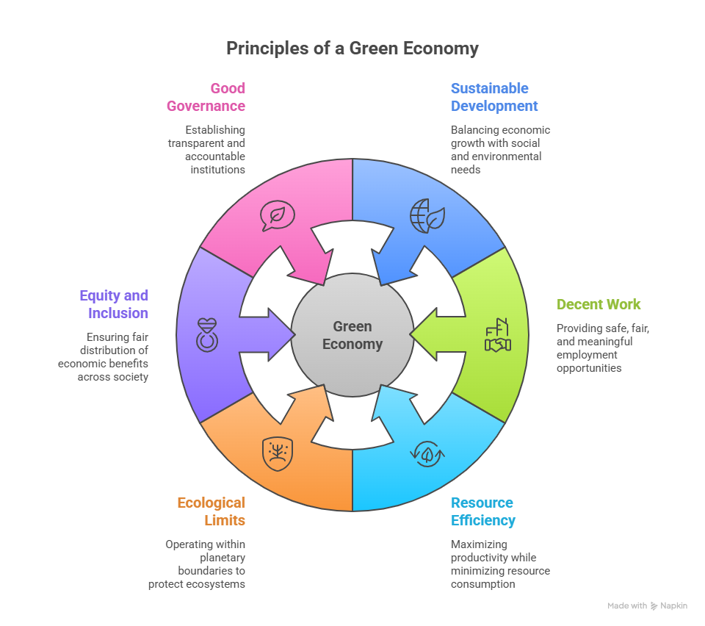
Principles for the green economy
Sustainable development - Promotes growth that supports social equity and environmental protection.
Decent work and green jobs - Creates safe, fair, meaningful jobs in sectors like renewable energy, eco-tourism, and sustainable agriculture.
Resource and energy efficiency - Maximizes productivity while reducing energy, water, and material use.

Slide 9
Principles for the green economy
Respect for ecological limits – Operates within planetary boundaries, avoiding overuse of land, water, and biodiversity.
Equity and social inclusion – Ensures economic benefits are shared fairly and vulnerable groups are supported.
Good governance and accountability -Relies on transparent, participatory, and accountable institutions..

Slide 10
Subtitle 1.2: Dimensions of the green economy – economic
Key aspects:
Green economy
Key economic areas within the green economy
Just transition and green jobs
Notes:
Question : do you already have ideas on your abstract subject ?
Prefer meeting before (OCs to brainstorm+each with subjects) or during CM ?

Slide 11
Green economy
Focuses on creating prosperity and jobs in environmentally responsible and socially inclusive ways.
Promotes qualitative growth (innovative, efficient, and sustainable) rather than just increasing production and consumption.
Emphasizes decoupling - separating economic growth from environmental degradation.
Uses innovation and circular economy practices (reuse, repair, recycling) to reduce resource use and pollution.

Slide 12
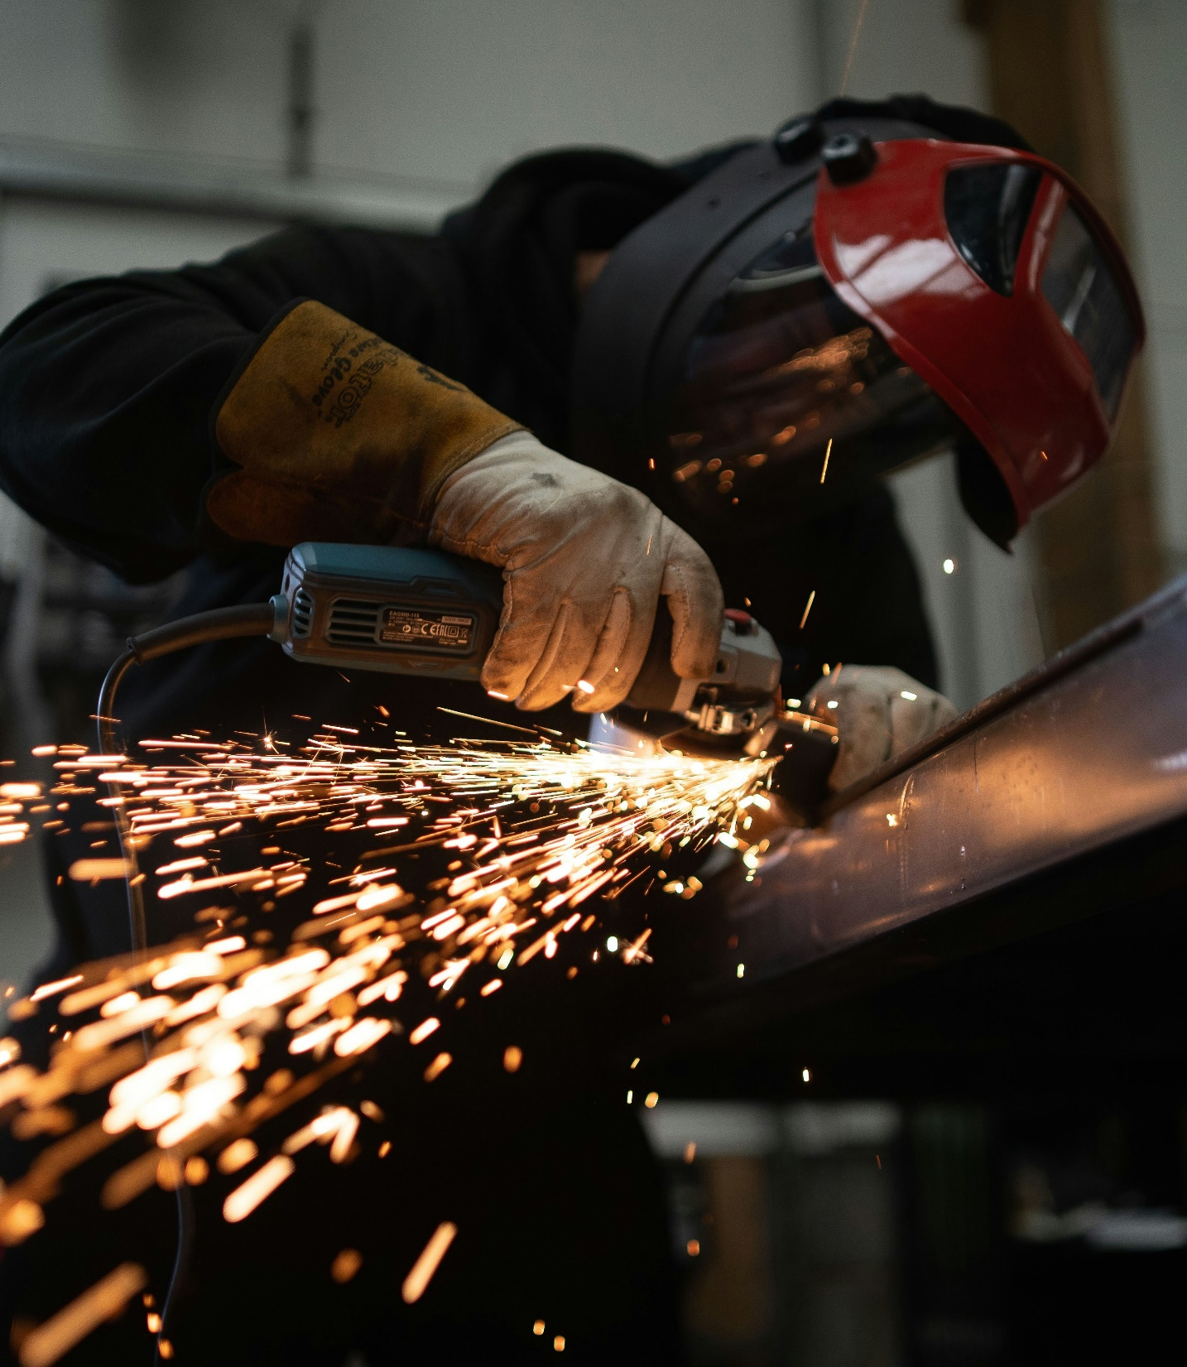
Key economic areas within the green economy
Renewable energy – solar, wind, hydro, and bioenergy provide cleaner alternatives to fossil fuels and are central to reducing greenhouse gas emissions; create a wide range of jobs
Green industry and manufacturing - Cleaner production processes minimize waste, cut emissions, and conserve energy. Innovations include circular design, eco-friendly supply chains, and carbon-neutral methods.
Sustainable agriculture - farming practices in a green economy aim to preserve soil health, maintain water quality, and reduce the use of chemical fertilizers and pesticides
Image by josh-beech-tXJhAFVOHVk-unsplash

Slide 13
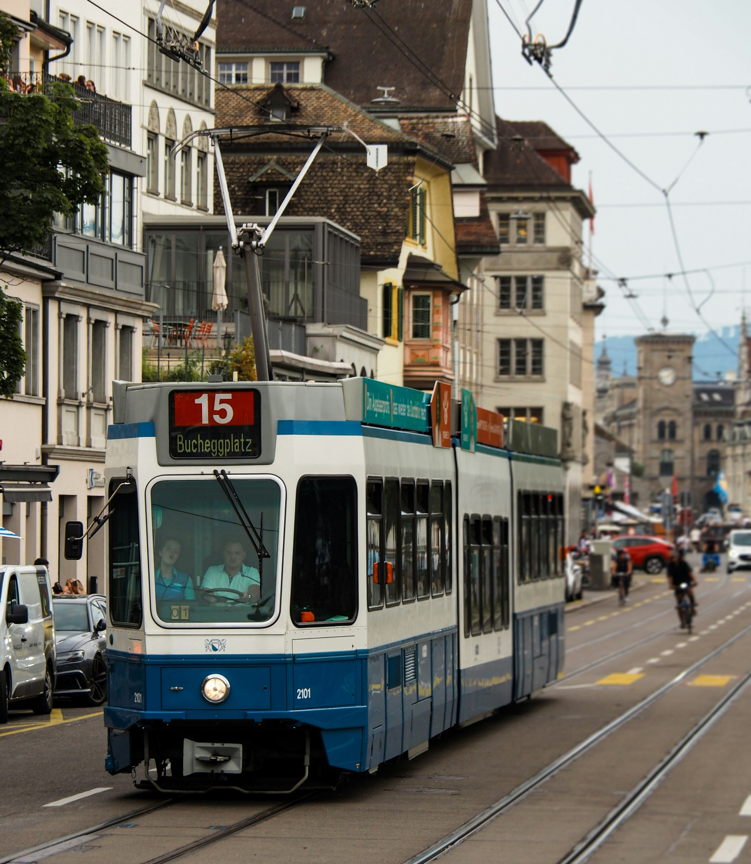
Key economic areas within the green economy
Green buildings and infrastructure - Energy-efficient construction, sustainable materials, and smart urban planning reduce emissions, enhance living standards, and build climate-resilient cities.
Sustainable transport – Low-emission vehicles, public transport, and cycling infrastructure cut fossil fuel use, improve air quality, and generate jobs in manufacturing and mobility services.
Waste management - A green economy promotes reducing waste, recycling, reuse, and innovative technologies like waste-to-energy and composting
Image by himmel-s-4LsgwnOewjQ-unsplash

Slide 14
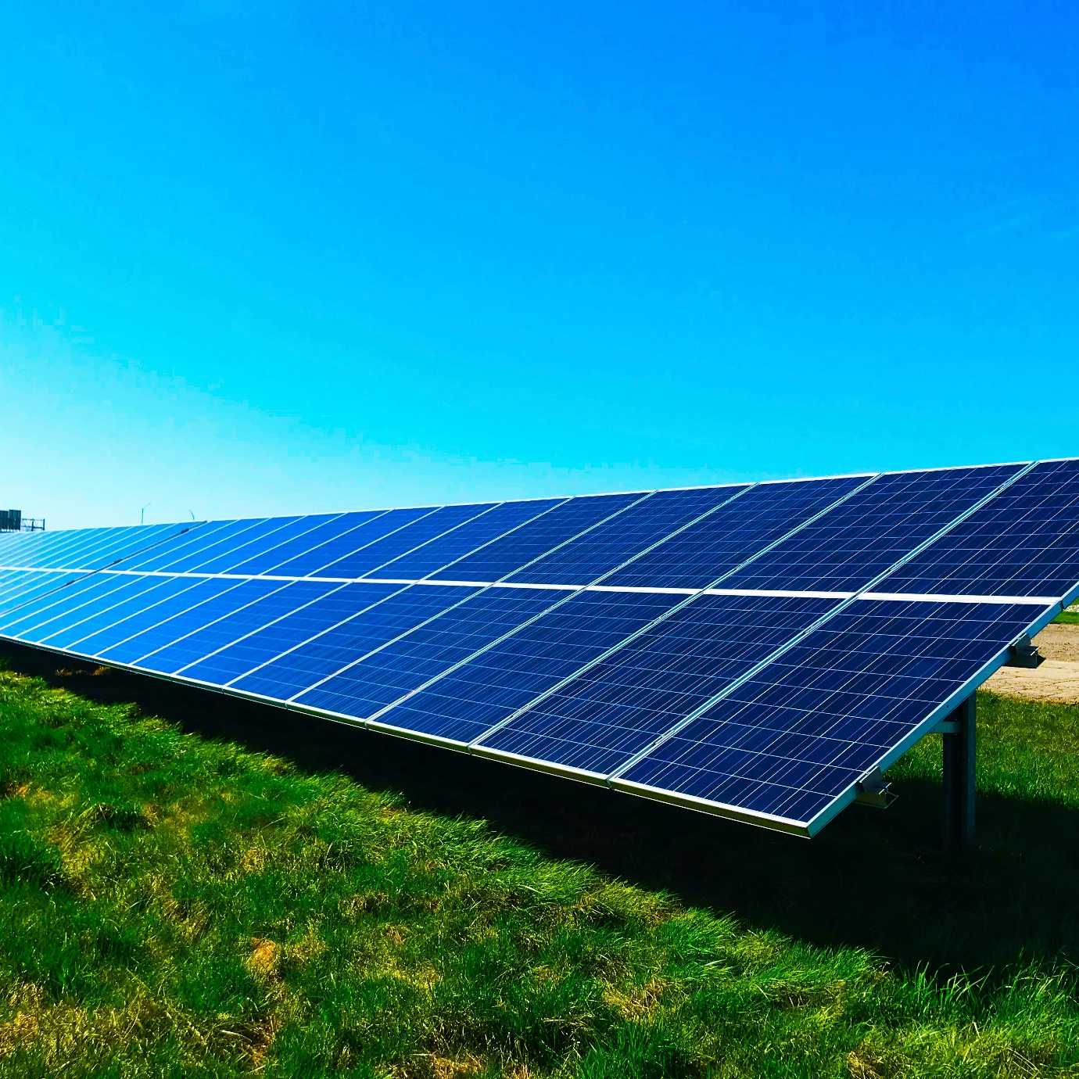
Just transition and green jobs
Green jobs – Jobs that preserve or restore the environment across sectors like renewable energy, agriculture, manufacturing, and waste management, improving employment quality and well-being.
What is just transition? – A fair, inclusive, and socially responsible shift to a green economy that supports workers, communities, and vulnerable groups while ensuring no one is left behind.
Just transition in action – Provides retraining, skills development, education, and local economic support to help workers and communities move into green sectors and sustainable livelihoods.
Image by chelsea-WvusC5M-TM8-unsplash

Slide 15
Subtitle 1.3: Dimensions of the green economy - social and environmental
Key aspects:
Social dimension
Environmental dimension
Notes:
Question : do you already have ideas on your abstract subject ?
Prefer meeting before (OCs to brainstorm+each with subjects) or during CM ?

Slide 16

Social dimension
Ensures sustainable growth benefits all, reducing inequality and empowering communities.
Provides fair access to green jobs, decent work, and skills development.
Promotes community access to clean energy, sustainable transport, and healthy environments.
Supports gender equality and youth inclusion to strengthen innovation and resilience.
Images by shane-rounce-DNkoNXQti3c-unsplash

Slide 17

Social dimension
Implementing a Just Transition
Uses social policies and protection to ensure fairness and prevent poverty.
Offers training and skills programs for workers to access green jobs.
Encourages community-led solutions tailored to local economic, social, and environmental needs.
Ensures the shift to a green economy is inclusive, equitable, and resilient.
Images by scott-graham-5fNmWej4tAA-unsplash

Slide 18
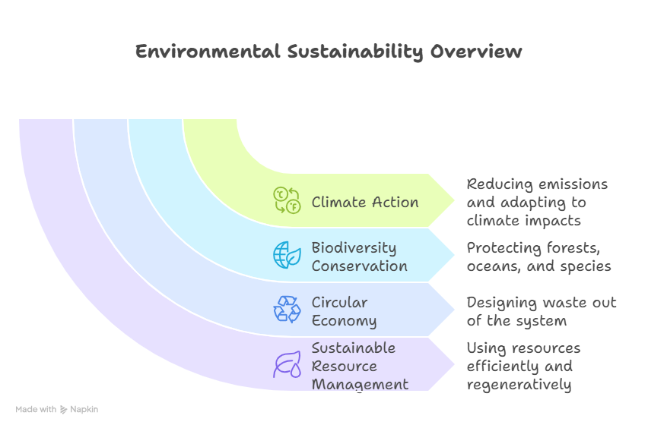
Economic dimension
Protects natural systems by addressing climate change, biodiversity loss, and resource depletion through sustainable production, conservation, and pollution reduction.

Slide 19
Module 2: Green policies, industries, and labour market Subtitle 2.1: Overview of green policies Subtitle 2.2: Impact on industries Subtitle 2.3: Labor market transformation
Bridging the Green & Digital Divide
Enhance the quality of vocational education and training (VET) in the Western Balkans for sustainable development.

Slide 20
Subtitle 2.1: Overview of green policies
Key aspects:
The Paris Agreement
United Nations Sustainable Development Goals (SDGs)
EU Green Deal
Country-specific policies
Notes:
Question : do you already have ideas on your abstract subject ?
Prefer meeting before (OCs to brainstorm+each with subjects) or during CM ?

Slide 21
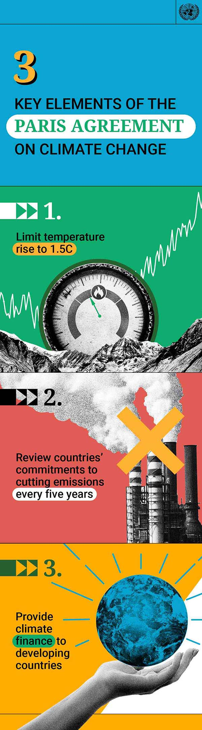
The Paris Agreement
The Paris Agreement is a landmark treaty that commits countries to limit global warming to well below 2°C, aiming for 1.5°C where possible.
National Commitments (NDCs) – Countries set emission reduction targets and promote renewable energy and energy efficiency.
Impact on green policies – Shapes regulations, investments, and sectoral skills demand.
Opportunities for VET – Growing need for trained professionals in renewable energy, energy auditing, and sustainable infrastructure.
Image by United Nations website

Slide 22
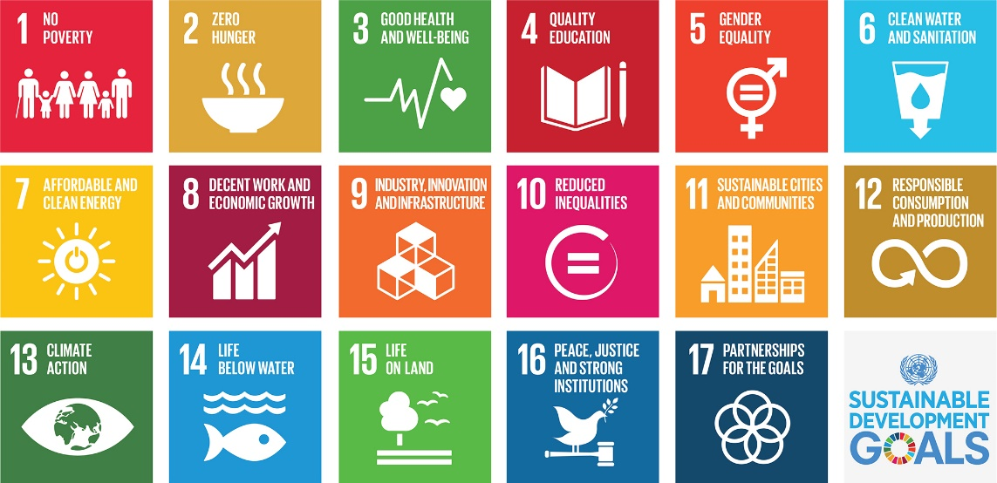
United Nations Sustainable Development Goals (SDGs)
The Sustainable Development Goals (UN) are a call for action by all countries – poor, rich and middle-income – to promote prosperity while protecting the planet. They recognize that ending poverty must go hand-in-hand with strategies that build economic growth and address a range of social needs including education, health, social protection, and job opportunities, while tackling climate change and environmental protection.
Image by United Nations

Slide 23
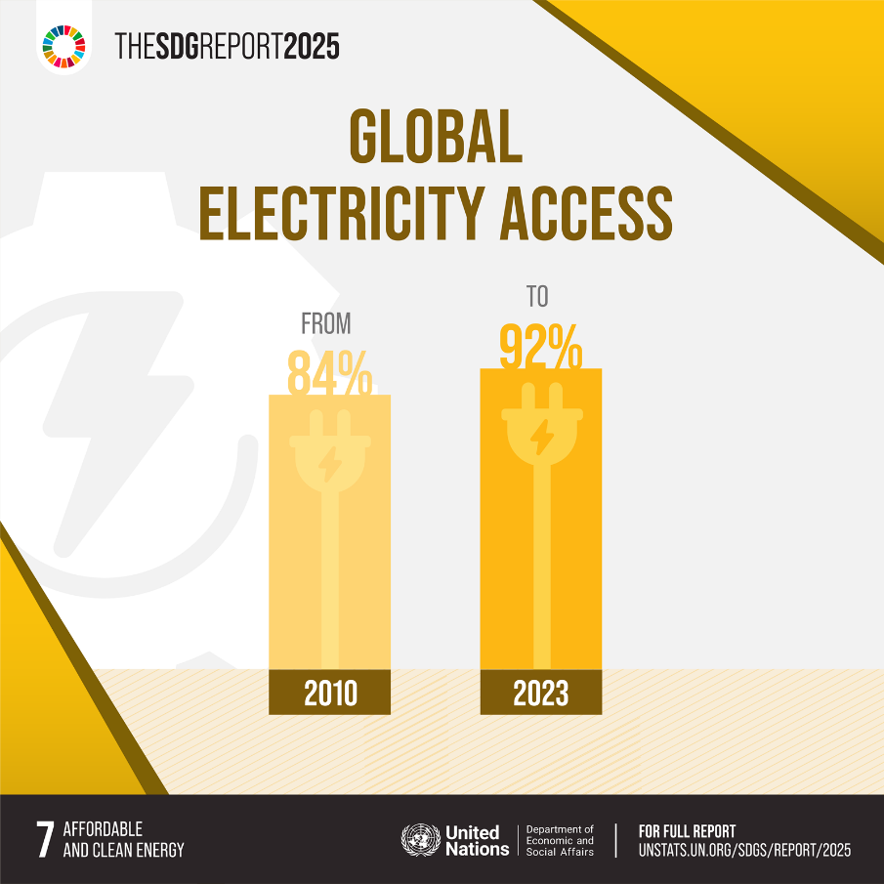
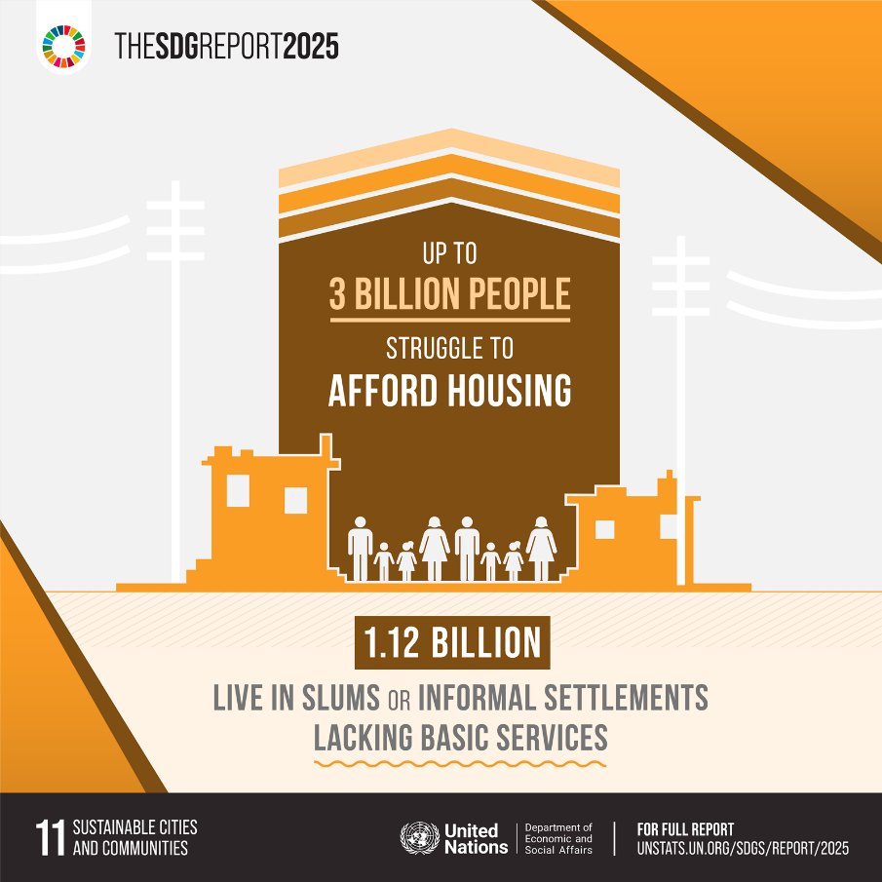
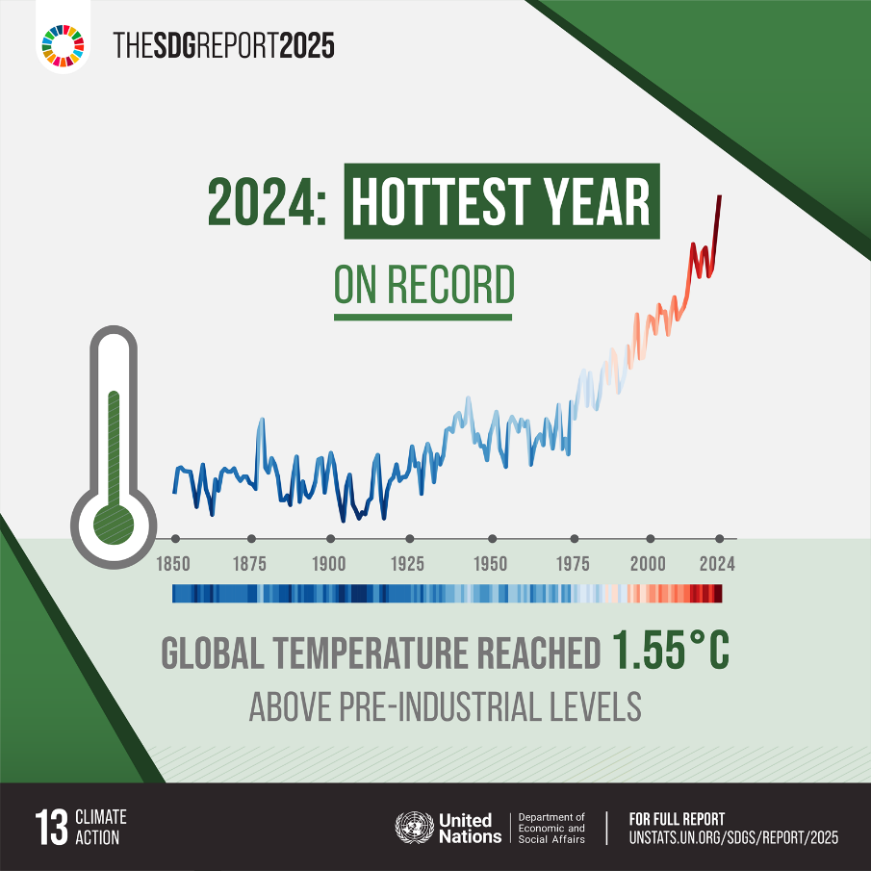
United Nations Sustainable Development Goals (SDGs)
Images by United Nations

Slide 24
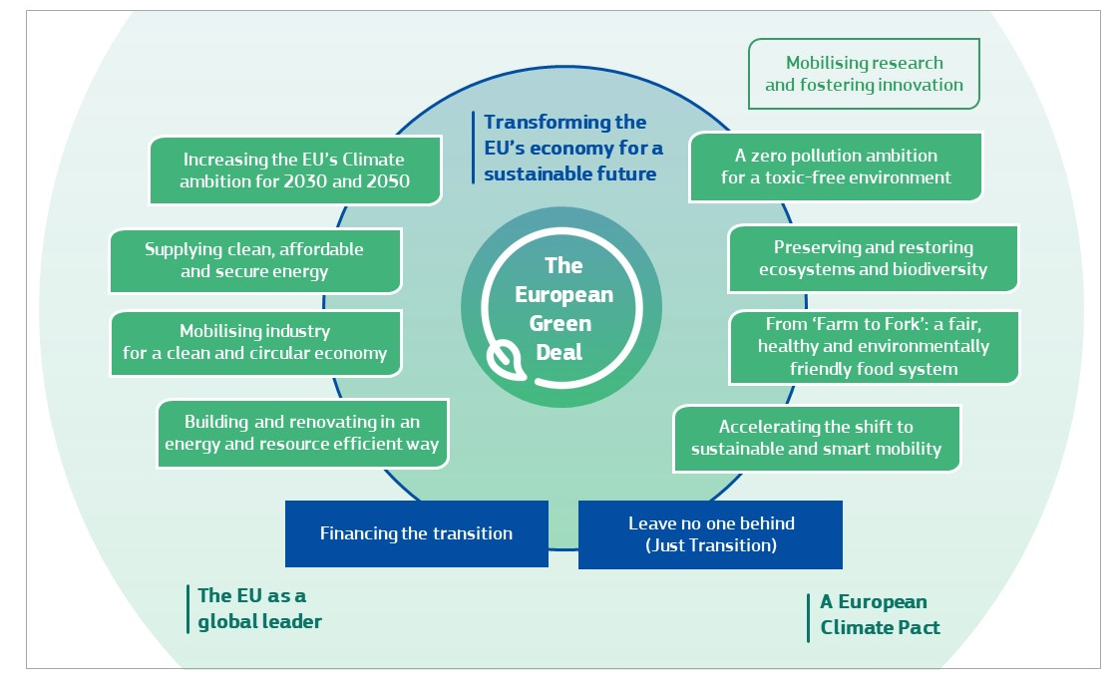
Policy framework
European Green Deal
The European Green Deal is the European Union’s flagship strategy to transform the European economy by 2050 into a climate-neutral system. It aims to reduce greenhouse gas emissions, decouple economic growth from resource use, and foster clean energy, sustainable transport, and biodiversity protection. By integrating environmental goals into every sector, it emphasizes that climate action, economic prosperity, and social equity are interconnected and mutually reinforcing.
Image by COMMUNICATION FROM THE COMMISSION TO THE EUROPEAN PARLIAMENT, THE EUROPEAN COUNCIL, THE COUNCIL, THE EUROPEAN ECONOMIC AND SOCIAL COMMITTEE AND THE COMMITTEE OF THE REGIONS

Slide 25
Country-specific policies
Germany’s Energiewende promotes a systematic shift from fossil fuels to renewable energy while encouraging energy efficiency and innovation.
France’s National Low-Carbon Strategy establishes sector-specific decarbonization targets and investment incentives for green technologies.
Italy’s National Energy and Climate Plan (NECP) outlines strategies for renewable energy deployment, energy efficiency, and greenhouse gas reduction, creating opportunities for skilled technicians and energy managers.
Image by chelsea-WvusC5M-TM8-unsplash

Slide 26
Subtitle 2.2: Impact on industries
Key aspects:
Industrial revolutions
European industries part of the industrial revolutions
Notes:
Question : do you already have ideas on your abstract subject ?
Prefer meeting before (OCs to brainstorm+each with subjects) or during CM ?

Slide 27
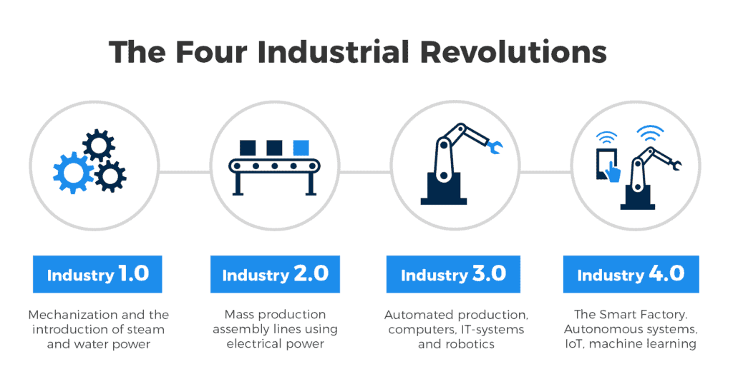
Industrial revolutions
First Industrial Revolution - Steam power and mechanized production created urban labour centers.
Second Industrial Revolution - Mass production and electrification fuelled productivity and consumer markets.
Third Industrial Revolution - Digitalization and automation enabled efficient, data-driven manufacturing.
Fourth Industrial Revolution - AI, IoT, and smart technologies transform production in real time.
Images by KFactory

Slide 28
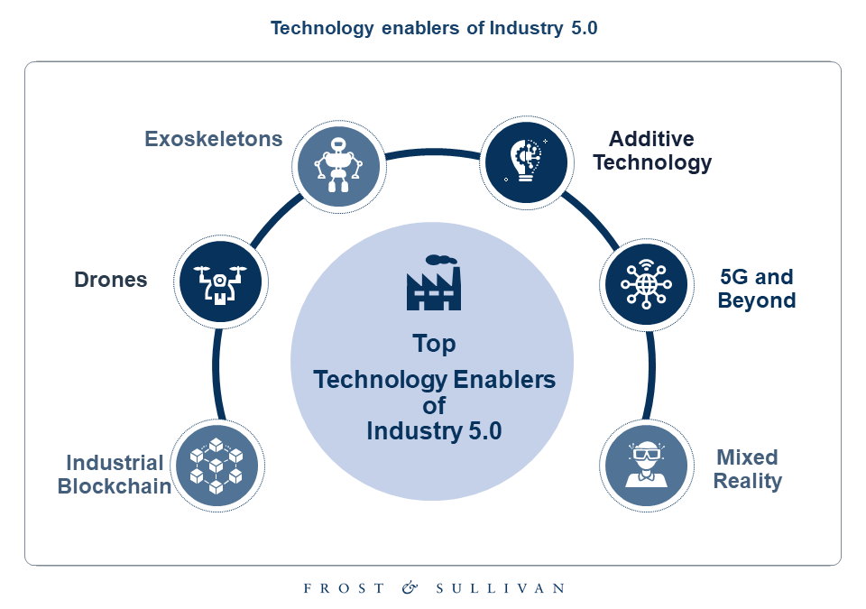
Industrial revolutions
Human-centric approach - integrates human creativity with advanced technologies for a more people-focused industry.
Collaboration with machines - AI and automation handle repetitive tasks, freeing humans for innovation and problem-solving.
Sustainability - prioritizes environmental responsibility and long-term industrial resilience.
Focuses not just on efficiency, but also on social well-being and ethical impact.
Images by Frost and Sullivan

Slide 29
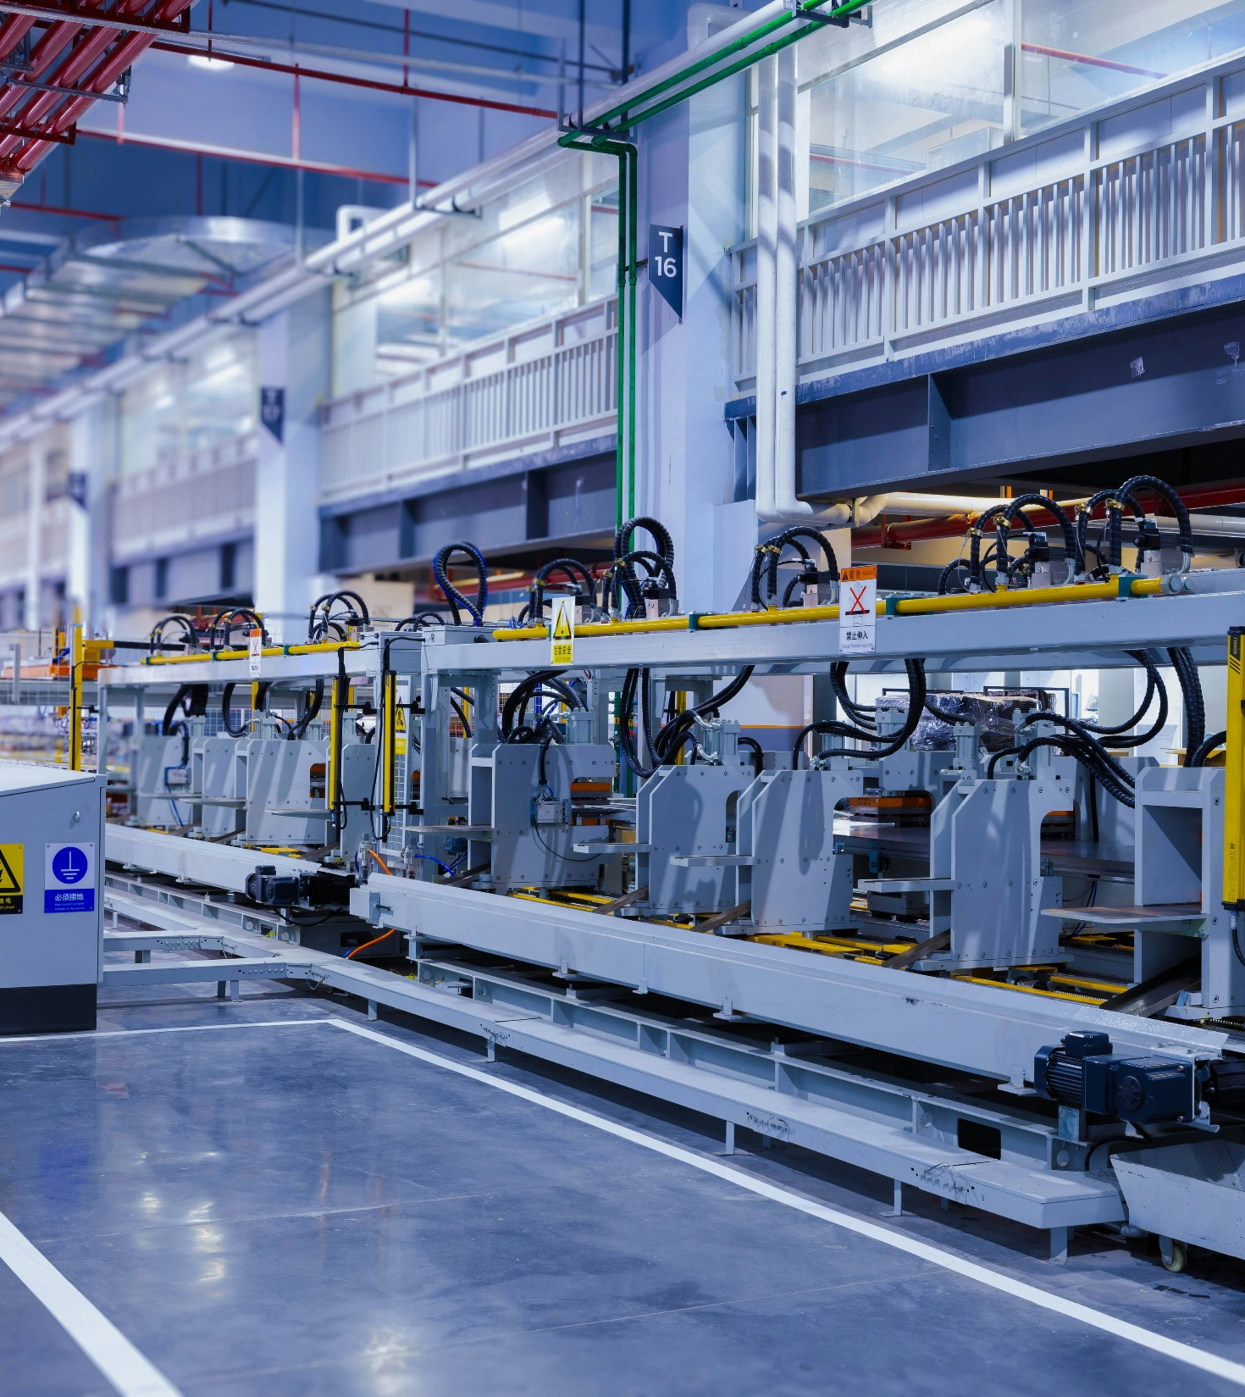
European industries part of the industrial revolutions
Energy
Transport and mobility
Manufacturing
Construction and infrastructure
Agriculture and food industry
Waste management and recycling
Water and environmental services
Digital and ICT
Image by homa-appliances-pWUyHVJgLhg-unsplash

Slide 30
Subtitle 2.3: Labour market transformation
Key aspects:
Labour market in numbers
Labour market transformation
Notes:
Question : do you already have ideas on your abstract subject ?
Prefer meeting before (OCs to brainstorm+each with subjects) or during CM ?

Slide 31
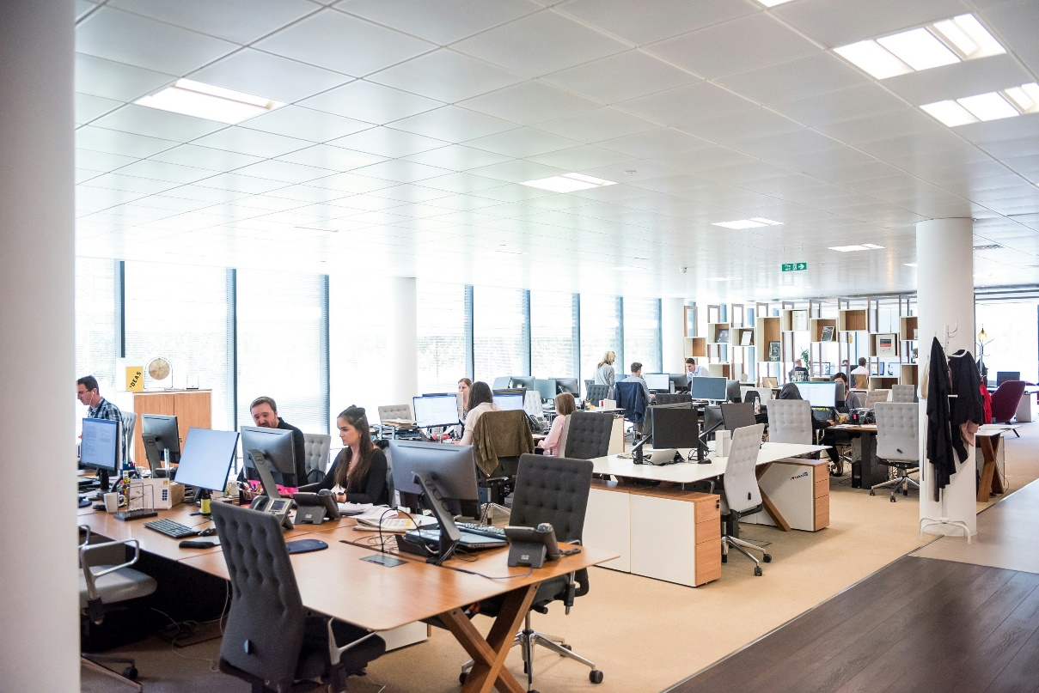
Labour market in numbers
Trends
Transforming labour market - green and digital transitions are reshaping skills, jobs, and industries.
Employment Statistics (2024/2025):
Overall unemployment: 5.9 %
Youth unemployment (15–24): 14.8 %
Job market is relatively tight, but skill mismatches emerge as industries evolve.
Images by arlington-research-kN_kViDchA0-unsplash

Slide 32

Labour market in numbers
Green skills and emerging trends
Rising demand for green skills - approximately 40 % of EU jobs require high/medium green transition skill intensity.
Global trends - job postings requiring green skills rose from 7.3 % (2023) to 7.7 % (2024).
Hiring gap - demand growing faster (11.6 %) than supply (5.6 %) of green-skilled workers.
Top green skills - Environmental engineering, renewable energy design, CSR, sustainable supply chains, ESG, green-digital data analysis.
Emerging professions - renewable-energy technicians, energy auditors, circular-economy managers, waste-to-resource engineers, sustainable-materials specialists, green policy planners, energy-market analysts, battery-algorithm engineers
Images by eric-prouzet-B3UFXwcVbc4-unsplash

Slide 33
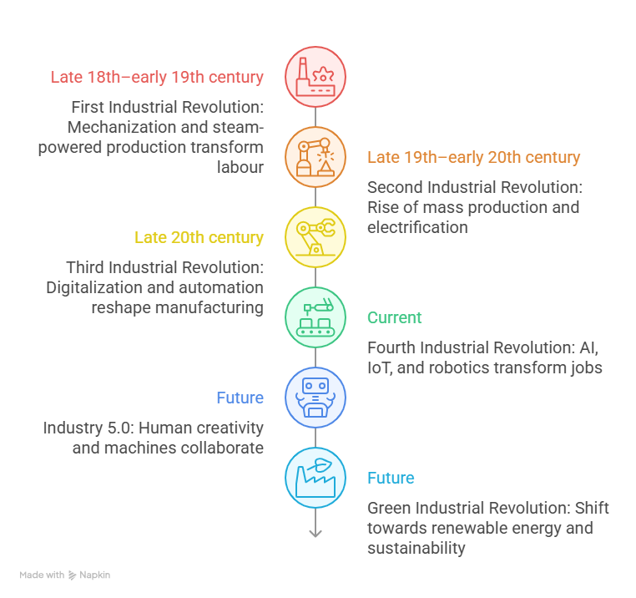
Labour market transformation
VET institutions must focus on cross-sectoral green skills, hands-on experience, industry collaboration, and lifelong learning to prepare workers for emerging green jobs.

Slide 34
Module 3: Circular economy and resource efficiency Subtitle 3.1: Basics of circular economy, acquaintance with the main documents Subtitle 3.2: Resource efficiency in practice and the link to circular economy Subtitle 3.3: Good examples of circular economy and resource efficiency implementation
Bridging the Green & Digital Divide
Enhance the quality of vocational education and training (VET) in the Western Balkans for sustainable development.

Slide 35
Subtitle 3.1: Basics of circular economy, acquaintance with the main documents
Key aspects:
Circular economy
“multi-R” approach
Circular economy – main documents
Notes:
Question : do you already have ideas on your abstract subject ?
Prefer meeting before (OCs to brainstorm+each with subjects) or during CM ?

Slide 36
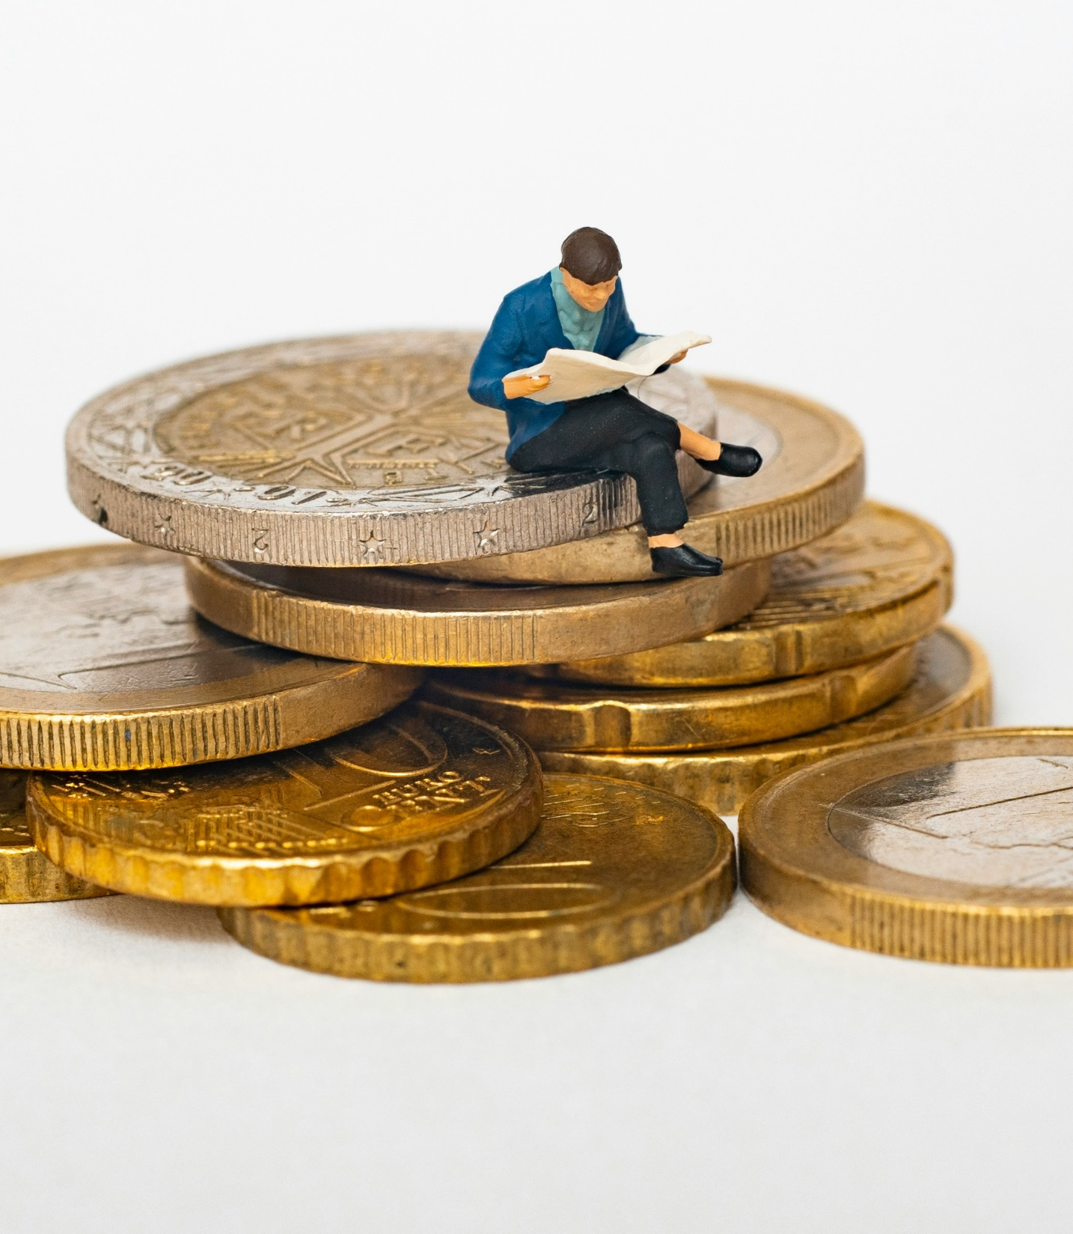
Circular economy
European commission - “The circular economy is a model of production and consumption, which involves sharing, leasing, reusing, repairing, refurbishing and recycling existing materials and products as long as possible. In this way, the life cycle of products is extended.”
Image by mathieu-stern-1zO4O3Z0UJA-unsplash

Slide 37









Linear economy
ADDING
VALUE
VALUE IS
LOST
Transport
Packaging
Assembly
Manufacturing
Processing
value collapses or is lost
Raw material extraction
"Negative value"
leading to disposal costs, pollution, and the need for replacement
BEFORE
USAGE
USAGE
Notes:
1.7.2013
Note: the purpose of this and the next four slides is to show the difference between linear and circular economy
The Value Hill can be used to depict the economy. Value is added every step of the way as a product moves „uphill”, on the left side: we take resources, process them, manufacture products, and get them to users.
‹#›

Slide 38


Circular economy
MULTI - R
APPROACH
ADDING
VALUE
RECOVERY OF
VALUE
Transport
Packaging
Reduce
Assembly
Manufacturing
Reuse
Processing
Repair
Raw material extraction
Recycle
BEFORE
USAGE
USAGE
Notes:
1.7.2013
Note: the purpose of this and the next four slides is to show the difference between linear and circular economy
The Value Hill can be used to depict the economy. Value is added every step of the way as a product moves „uphill”, on the left side: we take resources, process them, manufacture products, and get them to users.
‹#›

Slide 39
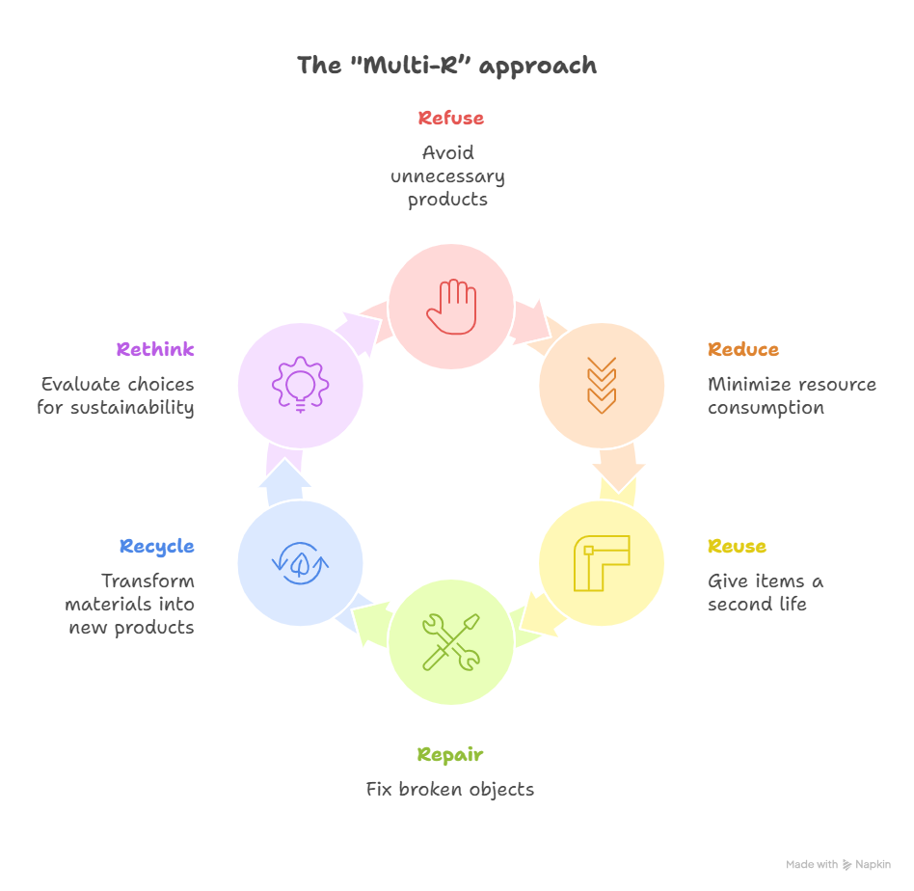
“multi-R” approach
Refuse
Reduce
Reuse
Repair
Recycle
Rethink
Case study: explore how each principle applies in daily life or professional contexts—from reducing material waste in manufacturing to maintaining tools and equipment for longer use.

Slide 40
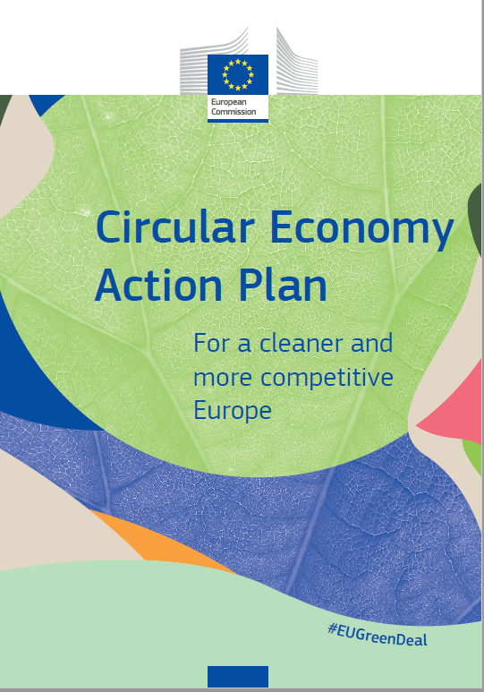
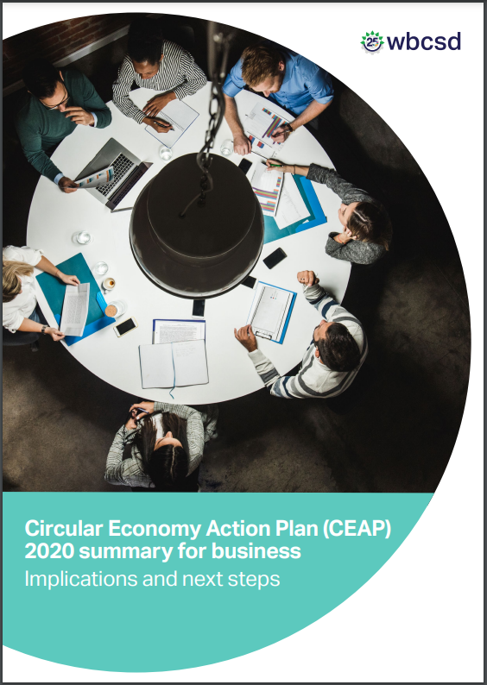


Circular economy
Main documents
Images by European Commission

Slide 41
Subtitle 3.2: Resource efficiency in practice and the link to circular economy
Key aspects:
Resource efficiency
Documents and resource efficiency
Link to circular economy
Notes:
Question : do you already have ideas on your abstract subject ?
Prefer meeting before (OCs to brainstorm+each with subjects) or during CM ?

Slide 42
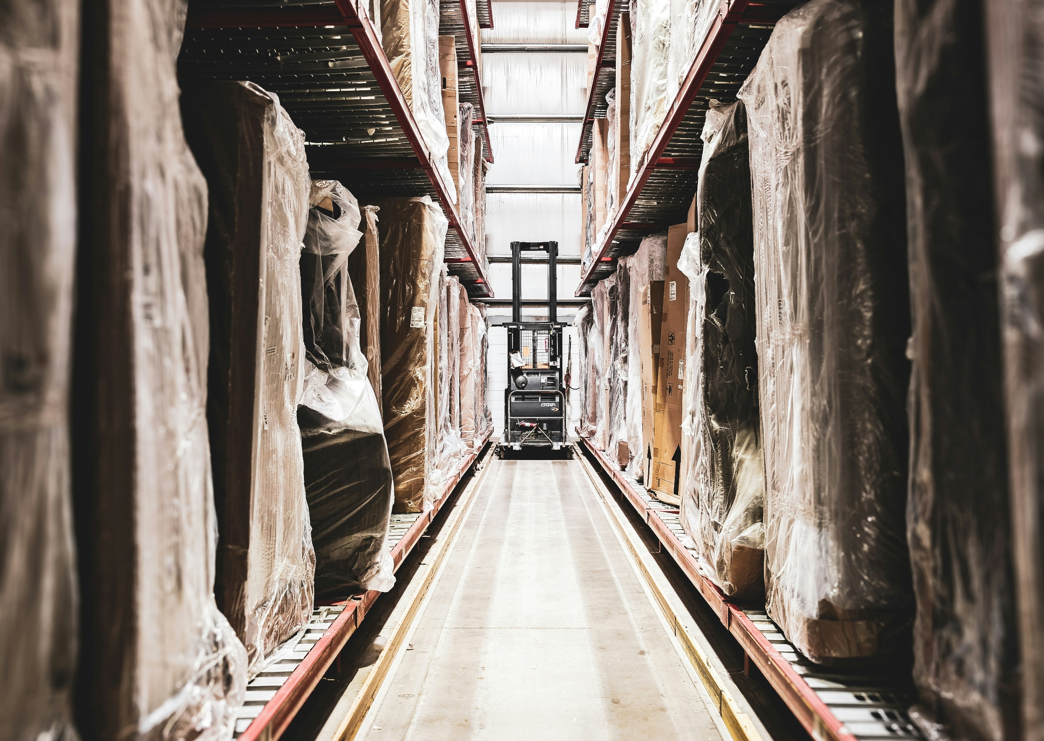
Resource efficiency
Resources - all the materials available in our environment which are technologically accessible, economically feasible and culturally sustainable and help us to satisfy our needs and wants
Resource efficiency - using natural resources in a way that maximizes their value throughout their life cycle while minimizing environmental impact
Image by ashley-_ZRWgz-a60Q-unsplash

Slide 43

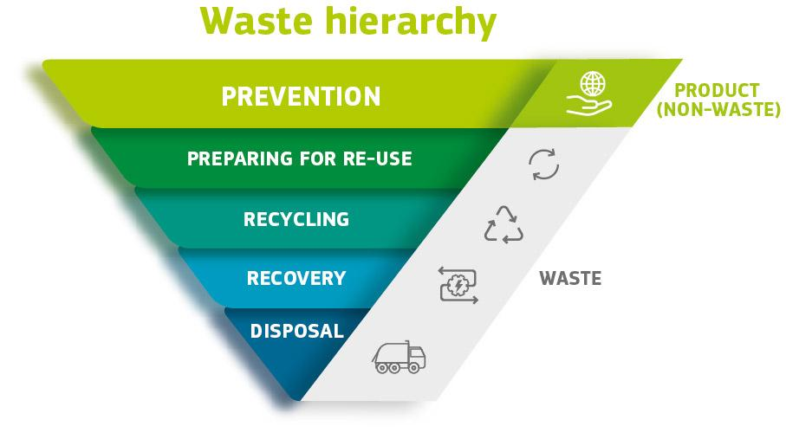
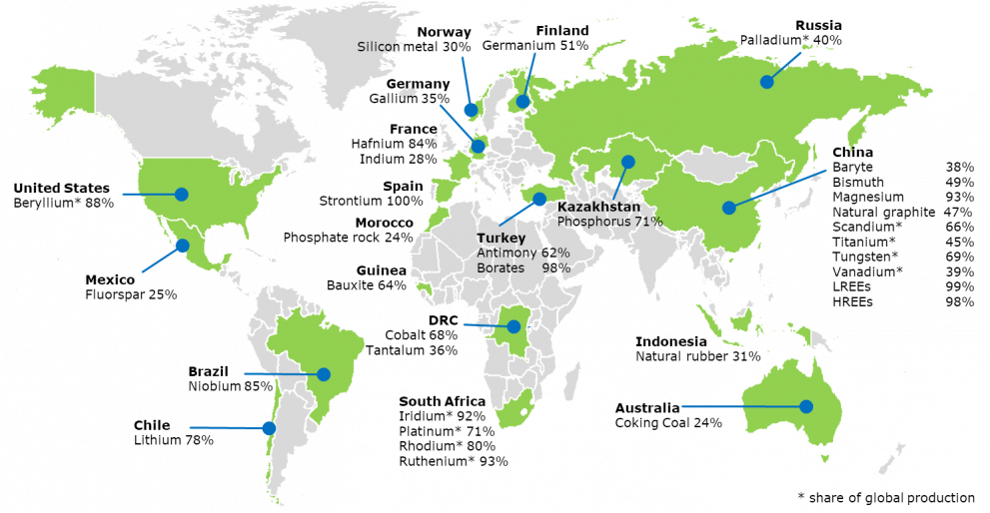
Documents and resource efficiency
Images by European Commission

Slide 44
Link to circular economy
MULTI - R
APPROACH
ADDING
VALUE
RECOVERY OF
VALUE
Transport
Packaging
Reduce
Assembly
Manufacturing
Reuse
Processing
Repair
Raw material extraction
Recycle
BEFORE
USAGE
USAGE
Notes:
1.7.2013
Note: the purpose of this and the next four slides is to show the difference between linear and circular economy
The Value Hill can be used to depict the economy. Value is added every step of the way as a product moves „uphill”, on the left side: we take resources, process them, manufacture products, and get them to users.
‹#›

Slide 45
Subtitle 3.3: Good examples of circular economy and resource efficiency implementation
Key aspects:
Energy communities
The Food Think Tank Foundation (FTT)
Notes:
Question : do you already have ideas on your abstract subject ?
Prefer meeting before (OCs to brainstorm+each with subjects) or during CM ?

Slide 46

Energy communities
Collaborative energy model where citizens, cooperatives, SMEs, and local authorities jointly produce, manage, and consume renewable energy.
Prioritize local environmental and social value over profit—lower emissions, reduce costs, improve efficiency, and build community resilience.
Innovative infrastructure & technologies: rooftop solar, small wind, shared batteries, and smart energy management systems.
federico-beccari-ahi73ZN5P0Y-unsplash

Slide 47

The Food Think Tank Foundation (FTT)
Unites chefs, designers, scientists, and artisans to apply sustainability and resource-efficiency principles in daily operations.
Surplus ingredients are transformed into pickles, ferments, jams, and vinegars; customers return jars for reuse, and neighbours share excess garden produce.
Unsellable food is redistributed through the Foodsi app, demonstrating how SMEs can turn waste into value while fostering local collaboration and responsible resource use.
Images by anna-pelzer-IGfIGP5ONV0-unsplash

Slide 48
Reflective activity Can you think of one process, system, or activity in your community or organization where applying green economy principles could create measurable social, economic, or environmental benefits? What would be the first small step you could take to make that process more sustainable? Who in your community or workplace could you collaborate with to make this change more effective? Can you identify a resource-intensive activity in your daily life or workplace where applying the six R principles (Refuse, Reduce, Reuse, Repair, Recycle, Rethink) could significantly improve efficiency and sustainability? Which of the six R’s could be implemented immediately? Which would require more planning or redesign? Are there materials or products in your context that could be repurposed or circulated locally rather than discarded? How could you encourage others to participate in closing these material loops? Can you think of a company, organization, or local initiative in your country that successfully applies circular economy practices or resource-efficiency strategies? What specific practices do they use that could inspire improvements in your own work, organization, or community? How could similar food-sharing or waste-prevention efforts be introduced where you live or work? What social benefits—such as community building or reduced inequality—might emerge from such initiatives?
Bridging the Green & Digital Divide
Enhance the quality of vocational education and training (VET) in the Western Balkans for sustainable development.

Slide 49







Thank you!
Cleantech Bulgaria

