Slide 1



Digital Skills – 3.1 Aligning Digital Skills Training with Labour Market Needs
Bridging the Green & Digital Divide
Enhance the quality of vocational education and training (VET) in the Western Balkans for sustainable development.

Slide 2


Learning outcomes
Use skills intelligence from labor-market sources to map existing VET competences against the DigComp 2.2 framework, identifying priority gaps and overlaps.
Design a structured Continuous Professional Development (CPD) plan that defines a target group, sets measurable learning outcomes, and selects appropriate training formats and resources.
Develop strategies for cultivating a responsive digital culture, including establishing support structures and creating a shared repository of resources to promote inclusive practices.

Slide 3
Course overview
Module 1: Skills intelligence and DigComp mapping
Subtitle 1.1: Gathering intelligence on current and emerging digital skills
Subtitle 1.2: Mapping competences to DigComp 2.2
Module 2: Developing a CPD Plan for VET Providers
Subtitle 2.1: Defining the CPD Purpose and Target Group
Subtitle 2.2: Writing Measurable Learning Outcomes
Module 3: Cultivating a Responsive Digital Culture
Subtitle 3.1: Models for Digital Upskilling
Subtitle 3.2: Designing Inclusive Digital Learning Materials
Subtitle 1.3: Gap and overlap Analysis
Subtitle 2.3: Selecting Training Modes and Resources
Subtitle 3.3: Creating a Central Resource Repository
Subtitle 3.4: Gathering intelligence on current and emerging digital skills

Slide 4
Module 1: Skills intelligence and DigComp mapping Subtitle 1.1: Gathering intelligence on current and emerging digital skills Subtitle 1.2: Mapping competences to DigComp 2.2 Subtitle 1.3: Gap and overlap analysis
Bridging the Green & Digital Divide
Enhance the quality of vocational education and training (VET) in the Western Balkans for sustainable development.

Slide 5
Subtitle 1.1: Gathering intelligence on current and emerging digital skills
Key aspects:
Learn to collect and review data from job briefs and sector snapshots to understand current labour-market demands.
Identifying emerging and advanced skills such as those related to automation, mechatronics, and digital service delivery.
Notes:
Question : do you already have ideas on your abstract subject ?
Prefer meeting before (OCs to brainstorm+each with subjects) or during CM ?

Slide 6
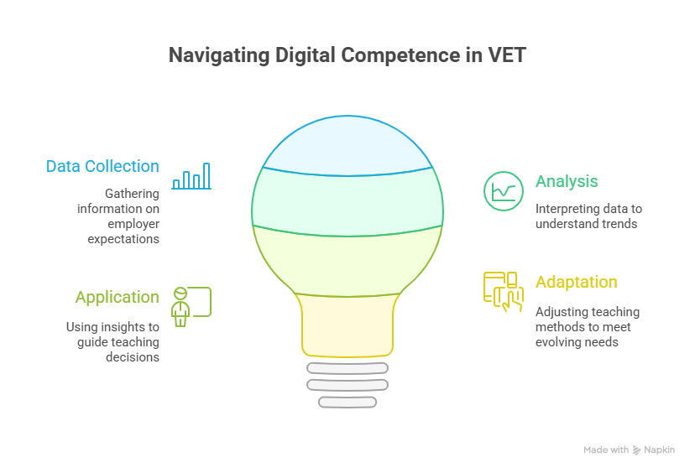
Why Skills Intelligence Matters
Digital tools shape almost every job today, and VET programs need to reflect what learners will face in real workplaces.
Skills intelligence helps educators see these changes clearly. It brings together signals from employers, job adverts, and sector reports to show which competences are becoming essential.
When educators look at this information regularly, they can update activities, examples, and exercises in a way that keeps learning relevant. This process supports stronger teaching decisions and helps learners build confidence in using digital tools that are already common in the workplace.

Slide 7

Image: karljosh16.unsplash
Finding the Right Information
Current labour market information appears in many places. Job postings show the tools and systems companies rely on each day.
Sector reports reveal how industries are evolving and which technologies are gaining importance. Databases like ESCO make it easier to understand how digital competences fit into different roles.
Local companies also provide insight when they mention tools used during apprenticeships or describe small changes in their work routines. When these sources are combined, educators get a clear picture of both current and emerging digital expectations.

Slide 8

Image: studentofprana.unsplash
Turning Data Into Practical Insights
Collecting information is only useful when it leads to clear decisions. Educators can meet in small groups to review findings and discuss what they mean for their programs.
Patterns usually appear quickly, such as repeated references to data handling or increased reliance on collaborative digital platforms. Once these patterns are identified, teachers can adjust lessons, introduce new tools, or strengthen activities that support digital readiness.
Creating a simple shared document to record these insights helps teams stay aligned and keeps information easy to update each semester.

Slide 9
Subtitle 1.2: Mapping Competences to DigComp 2.2
Key aspects:
Understand the structure of the DigComp 2.2 framework and practice mapping existing or planned VET competences to its different areas.
Notes:
Question : do you already have ideas on your abstract subject ?
Prefer meeting before (OCs to brainstorm+each with subjects) or during CM ?

Slide 10
Seeing Your Program Through DigComp
Mapping competences begins with understanding what your learners already do in your program and how these activities connect to the DigComp 2.2 framework.
DigComp offers clear areas that describe digital behavior in everyday tasks, from handling information to creating content or solving problems with technology. When educators use these areas as a reference point, they can look at existing lessons with fresh eyes.
Even simple activities such as using online documents or completing tasks on a learning platform already introduce elements of digital competence.
Recognizing these connections helps teachers understand the digital strengths already present in their courses.

Slide 11
Making the First Competence Map
A first mapping exercise does not need to be complex.
It can start with a simple table where each course is placed next to the DigComp areas it touches. Teachers can then add notes about what learners actually do in practice and how confident they seem when working with digital tasks.
This first version does not need perfect detail. Its purpose is to reveal the overall picture of where digital learning already happens and which competences appear most often.
Once this map exists, educators can compare it with what the labour market expects and begin to see where new or updated content may be needed.

Slide 12
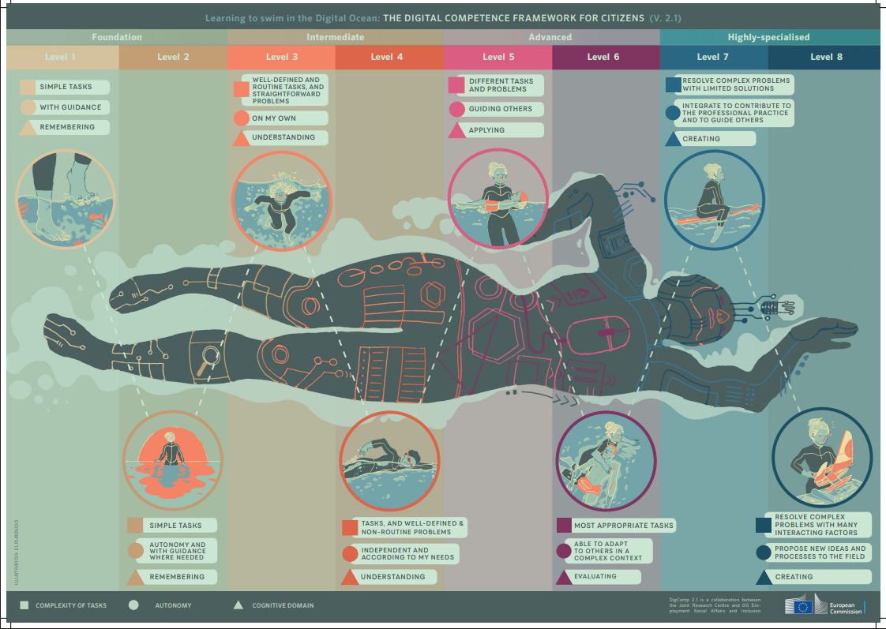
Image: joint-research-centre.ec.europa.eu/digcomp-framework-poster

Slide 13
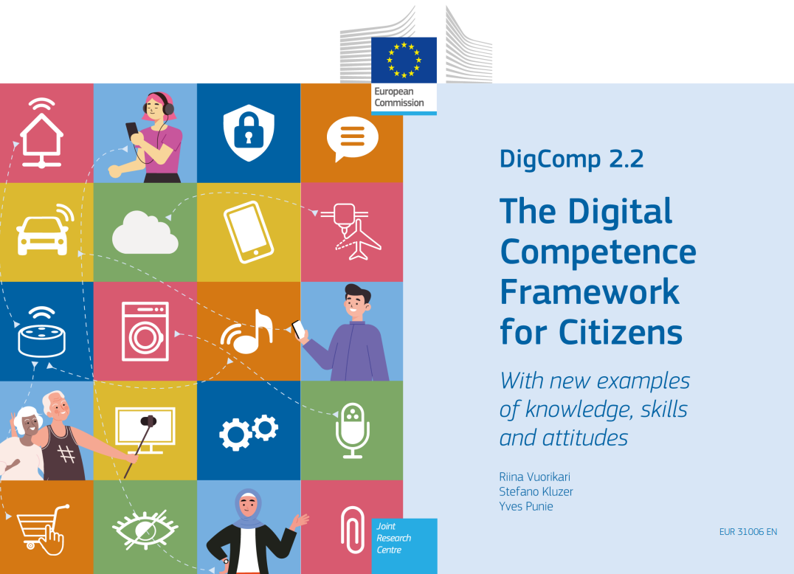
Building a Shared Understanding
Each educator notices different digital elements in their own subject, and sharing these observations helps create a more accurate overview.
One teacher may see opportunities to strengthen digital safety, while another recognizes activities linked to communication or collaboration.
Discussing these layers builds a common language around digital competence and helps teams agree on priorities.
DigComp 2.2: The Digital Competence Framework for Citizens - With new examples of knowledge, skills and attitudes, EUR 31006 EN, Publications Office of the European Union, Luxembourg, 2022, ISBN 978-92-76-48882-8, doi:10.2760/115376, JRC128415.

Slide 14
Subtitle 1.3: Gap and Overlap Analysis
Key aspects:
Use the results of the mapping exercise to perform a gap analysis, clearly identifying which digital competences are underdeveloped or missing in the current VET offer.
Notes:
Question : do you already have ideas on your abstract subject ?
Prefer meeting before (OCs to brainstorm+each with subjects) or during CM ?

Slide 15
Understanding Gaps and Overlaps
Once the mapping is complete, the next step is to look closely at what the results show.
Gaps appear when a competence that employers consider important is not present in the current program. Overlaps appear when the same digital activity is repeated across several courses without adding new value.
These patterns help educators understand how well their program prepares learners for real digital tasks. When teachers interpret gaps and overlaps together, the map becomes more than a document. It becomes a guide for improving digital readiness in a structured and realistic way.

Slide 16
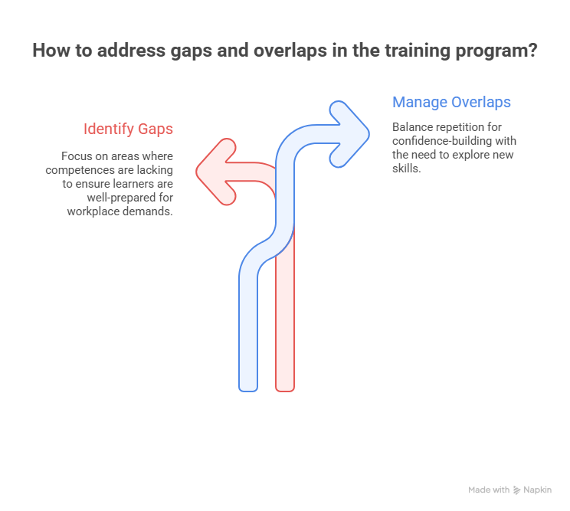
Linking Findings to Workplace Expectations
The importance of a gap depends on what employers expect from new workers. If companies rely heavily on digital communication tools or data dashboards and these competences are weak in the program, the gap becomes significant.
Overlaps also need attention when they limit space to explore more advanced skills. Reviewing the map alongside sector trends and local employer feedback helps educators identify which areas must be strengthened first.

Slide 17
Turning Analysis Into Action
Gap and overlap analysis becomes valuable when it leads to practical decisions.
Educators can use the findings to adjust lessons, integrate new tools, or create activities that address missing competences. Some improvements may require new materials, while others can be introduced through small updates to existing tasks.
Summarizing the results in a simple overview helps teams prioritize and plan the next steps. This clarity supports a more balanced digital offer and prepares the institution for further work in designing a strong and targeted CPD plan.

Slide 18
Module 2: Developing a CPD Plan for VET Providers Subtitle 2.1: Defining the CPD Purpose and Target Group Subtitle 2.2: Writing Measurable Learning Outcomes Subtitle 2.3: Selecting Training Modes and Resources
Bridging the Green & Digital Divide
Enhance the quality of vocational education and training (VET) in the Western Balkans for sustainable development.

Slide 19
Subtitle 2.1: Defining the CPD Purpose and Target Group
Key aspects:
Learn to state the context and objectives of a CPD plan based on skills intelligence
Define the target audience
Notes:
Question : do you already have ideas on your abstract subject ?
Prefer meeting before (OCs to brainstorm+each with subjects) or during CM ?

Slide 20
Setting a Clear Direction for CPD
A CPD plan only becomes meaningful when it has a clear purpose.
This purpose explains what the institution wants to improve and why the improvement matters. It should link directly to the digital gaps identified earlier, so the plan responds to real needs rather than general intentions.
When educators understand the purpose, they can see how their participation connects to learner outcomes and labour market expectations. A clear purpose also helps avoid scattered initiatives and brings focus to the development process.
Image by noah-buscher-x8ZStukS2PM-unsplash

Slide 21
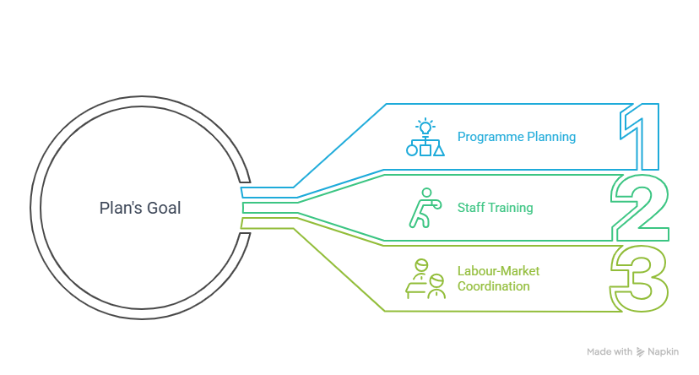
The purpose of a CPD plan should come from what the institution has already observed in its programs. If teams struggle with mapping digital competences, the purpose might focus on strengthening this ability.
If staff rarely use labour market information, the purpose might aim to build confidence in interpreting data.
Connecting Purpose With Evidence
When the purpose is grounded in evidence, the CPD plan becomes more achievable and easier to communicate.

Slide 22
Identifying the Right Participants
Once the purpose is defined, the next step is choosing the target group. This group includes the staff who need to develop specific competences in order to meet the CPD goals. It may involve program coordinators, subject teachers, or teams who prepare assessments.
Selecting the right participants ensures that the plan leads to visible change. A focused target group also makes it easier to design activities that match their roles and starting points. When participants understand why they were chosen and how their learning contributes to the institution’s strategy, the CPD plan gains stronger engagement and clearer results.
Image by artem-balashevsky-Ld-5Lu-eU6A-unsplash

Slide 23
Subtitle 2.2: Writing Measurable Learning Outcomes
Key aspects:
Practice creating effective learning outcomes ensuring it is linked to a specific DigComp 2.2 competence area
Notes:
Question : do you already have ideas on your abstract subject ?
Prefer meeting before (OCs to brainstorm+each with subjects) or during CM ?

Slide 24
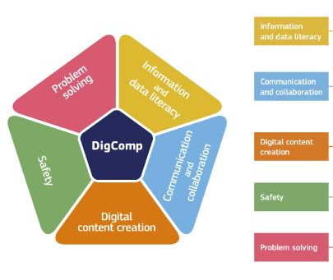
Why Learning Outcomes Matter
Learning outcomes show what participants should be able to do after completing the CPD plan. They make progress visible and help teams understand what the plan is trying to achieve.
When outcomes are written clearly, everyone knows what skills or knowledge will change and how this change supports the wider goal of aligning digital competences with labour market needs.
Clear outcomes also create a shared understanding among staff and make it easier to evaluate the plan later.
Image by annie-spratt-a3mXEG8AEx8-unsplash

Slide 25
Turning Purpose Into Concrete Results
To write effective learning outcomes, educators start by looking at the purpose of the CPD plan.
The outcome should describe an action that can be observed, such as identifying digital trends, applying a framework, or analyzing competence gaps. Using simple verbs helps show what participants will actually do in practice.
Outcomes also need to be realistic for the time available. When outcomes are concise and achievable, they guide trainers in selecting the right activities and resources.
Image by bogdan-karlenko-36b7JBzhfF4-unsplash

Slide 26
Creating Outcomes That Support Real Needs
To write effective learning outcomes, educators start by looking at the purpose of the CPD plan.
Good learning outcomes are specific, relevant, and connected to real workplace expectations. They focus on abilities that help the institution respond to digital changes rather than general knowledge that is difficult to apply.
When participants can demonstrate what they learned through a task, discussion, or small project, the outcome is measurable. These outcomes make evaluation easier and ensure that the CPD plan leads to meaningful improvements in how digital competences are understood and taught.
Image by bogdan-karlenko-36b7JBzhfF4-unsplash

Slide 27
Subtitle 2.3: Selecting Training Modes and Resources
Key aspects:
Review and select appropriate training formats and delivery modes, while identifying necessary resources and accessibility needs.
Notes:
Question : do you already have ideas on your abstract subject ?
Prefer meeting before (OCs to brainstorm+each with subjects) or during CM ?

Slide 28
Choosing Training Modes That Fit Your Context
Selecting the right training mode is essential for making the CPD plan practical and achievable.
Staff often have limited time, so the mode must fit their routines without reducing the quality of learning.
Short sessions, simple online modules, or blended formats can make participation easier while still supporting meaningful development.
The goal is to choose approaches that match the learning outcomes and reflect how digital competences are used in real teaching situations.

Slide 29
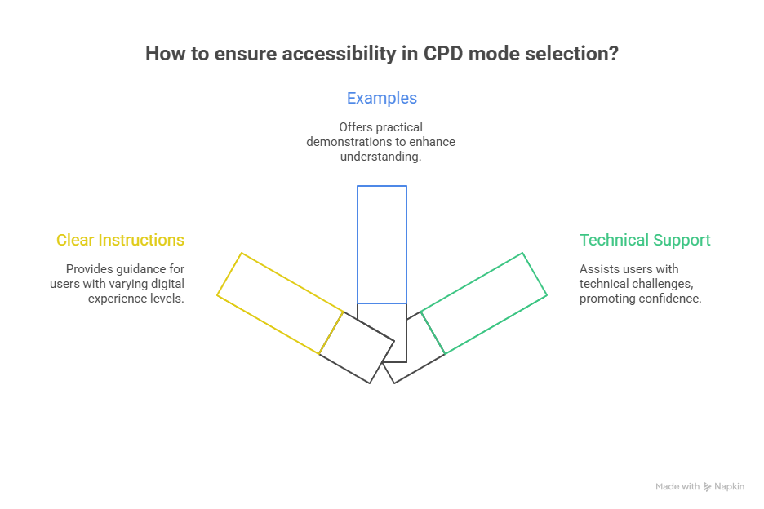
Creating Learning Experiences That Are Useful and Realistic
The most effective CPD activities are those that connect learning to everyday tasks. When staff work with real examples, such as reviewing labour market data or using the DigComp framework during the session, the training becomes immediately relevant.
Adults learn best through practical tasks, clear examples, and opportunities to experiment.

Slide 30
Using Resources That Support Sustainable Learning
Training modes need to be supported by reliable resources. These may include internal guides, shared templates, simple mapping tools, or examples of good practice already used in the institution.
External resources such as DigComp materials or sector reports can also strengthen activities without requiring new content to be created from scratch. When resources are easy to access and well integrated, they help staff continue learning after the session ends and make the CPD plan more sustainable over time.

Slide 31
Module 3: Cultivating a Responsive Digital Culture Subtitle 3.1: Models for Digital Upskilling Subtitle 3.2: Designing Inclusive Digital Learning Materials Subtitle 3.3: Creating a Central Resource Repository Subtitle 3.4: Strategies for Industry Collaboration
Bridging the Green & Digital Divide
Enhance the quality of vocational education and training (VET) in the Western Balkans for sustainable development.

Slide 32
Subtitle 3.1: Models for Digital Upskilling
Key aspects:
Explore and compare few different models for professional development, including short refreshers, formal online courses, peer mentoring, and practical workshops.
Notes:
Question : do you already have ideas on your abstract subject ?
Prefer meeting before (OCs to brainstorm+each with subjects) or during CM ?

Slide 33
Why Ongoing Upskilling Matters
Digital competences change quickly, and a single training session is not enough to keep staff aligned with workplace expectations.
Ongoing upskilling helps institutions stay responsive to new tools and methods. It gives teachers regular opportunities to explore digital practices, reflect on their use, and gradually build confidence.
When upskilling becomes part of everyday routine, digital development feels natural rather than demanding, and staff are better prepared to support learners in a changing labour market.
Image by alvaro-reyes-qWwpHwip31M-unsplash

Slide 34
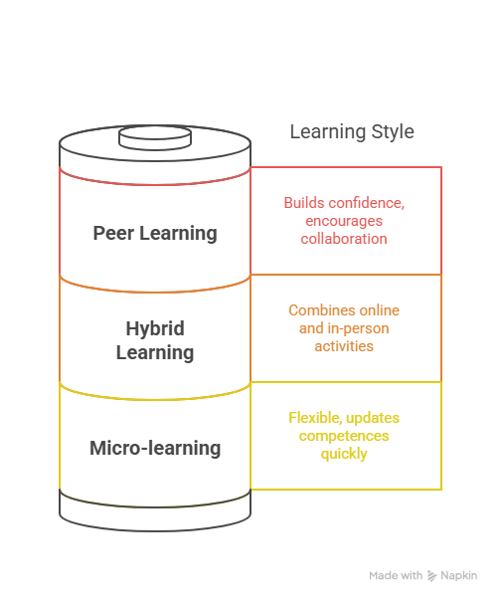
Different Ways to Support Continuous Learning
Institutions can use several models to support ongoing digital growth.
Short learning moments, such as micro sessions or brief demonstrations, help staff learn without feeling overloaded. Peer learning offers a space where colleagues share practical tips and observe each other’s methods.
Blended approaches that mix online and in-person activities give staff flexibility while reinforcing new skills through practice.
Image by olav-ahrens-rotne-4Ennrbj1svk-unsplash

Slide 35
Choosing Models That Build Long-Term Progress
The most effective upskilling strategy is one that combines several models in a balanced way. Quick sessions introduce new ideas, peer learning strengthens confidence, and blended formats give space for deeper exploration.
When these approaches are repeated over time, they create a cycle of improvement that keeps skills current.
This gradual, continuous process helps institutions remain agile, respond to digital trends, and maintain a strong connection between teaching practices and workplace realities.
Image by ux-indonesia-qC2n6RQU4Vw-unsplash

Slide 36
Subtitle 3.2: Designing Inclusive Digital Learning Materials
Key aspects:
Learn how to establish an effective support system through a network of digital champions, dedicated help channels, and peer-support groups.
Notes:
Question : do you already have ideas on your abstract subject ?
Prefer meeting before (OCs to brainstorm+each with subjects) or during CM ?

Slide 37
Making Digital Materials Accessible for Everyone
Inclusive digital materials give all learners the chance to participate with confidence.
Creating content that is easy to understand, visually clear, and compatible with different learning needs. Small choices, such as using simple language, clear layouts, and readable visuals, help remove barriers that might otherwise limit engagement.
When materials are designed with inclusion in mind, learners feel supported and more willing to explore digital tasks.

Slide 38
Designing Content That Supports Diverse Learners
Learners bring different levels of digital experience and different types of strengths to the classroom. Inclusive materials recognize this diversity by offering explanations, examples, and formats that suit various learning preferences.
Combining visuals, short texts, and practical tasks helps learners follow along even if they are less confident with technology.
When materials guide learners' step by step and provide room for practice, digital tasks become manageable and less intimidating.

Slide 39
Keeping Materials Clear, Practical, and Easy to Update
Inclusive design becomes sustainable when materials are simple to maintain.
Using templates, structured layouts, and clear instructions helps teachers update content without starting from zero. Practical examples taken from real work situations make learning more relevant and help learners see how digital tools are used outside the classroom.
When materials are easy to adapt, institutions can keep them aligned with digital changes in the labour market and ensure all learners benefit from consistent support.

Slide 40
Subtitle 3.3: Creating a Central Resource Repository
Key aspects:
Plan the creation and maintenance of a shared repository for digital tools, best-practice guides, and learning materials to ensure consistency and promote inclusive practices.
Notes:
Question : do you already have ideas on your abstract subject ?
Prefer meeting before (OCs to brainstorm+each with subjects) or during CM ?

Slide 41
Why a Shared Repository Matters
A central resource repository brings all digital materials, tools, and examples into one organized place. It helps educators access what they need quickly, reduces duplicated work, and makes it easier to maintain consistency across programs.
When resources are stored together, staff can build on each other's ideas and keep materials aligned with the institution’s digital goals. Over time, the repository becomes a shared memory that supports teaching and development.

Slide 42
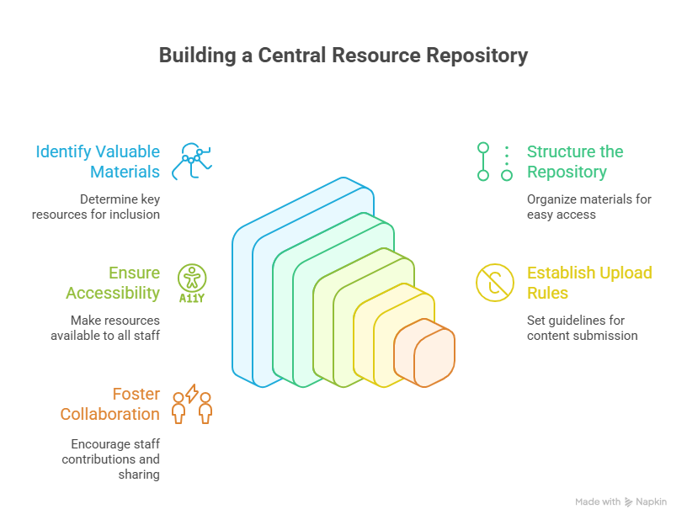
Organizing Resources for Practical Use

Slide 43
Keeping the Repository Active and Relevant
A repository remains useful only when it is regularly updated. Assigning responsibility to a small team or rotating group helps ensure that new materials are added and older ones reviewed.
Encouraging teachers to contribute after workshops or classroom experiments brings fresh insights and strengthens collaboration.
When updates happen consistently, the repository reflects current digital needs and becomes a reliable tool that supports the institution’s long-term development.

Slide 44
Subtitle 3.4: Strategies for Industry Collaboration
Key aspects:
Explore practical methods for building and maintaining strong partnerships with local businesses.
Establishing industry advisory boards, co-designing curriculum modules, and creating opportunities for guest lectures.
Notes:
Question : do you already have ideas on your abstract subject ?
Prefer meeting before (OCs to brainstorm+each with subjects) or during CM ?

Slide 45
Building Meaningful Connections With Industry
Industry collaboration helps VET institutions stay connected to the digital tools and practices used in real workplaces.
These connections go beyond formal partnerships and start with regular conversations that reveal what companies expect from new workers.
When teachers hear directly from employers, they gain clearer insight into how digital tasks are performed and which competences are rising in importance.
This ongoing exchange strengthens trust and creates a shared understanding of how training can better prepare learners for digital demands.

Slide 46
Making Collaboration Part of Everyday Practice
Collaboration becomes most valuable when it is built into the institution’s routine rather than treated as occasional outreach. Short meetings, informal check-ins, or small joint activities can provide continuous updates on how industries are using technology.
Inviting employers to comment on teaching materials or to share the digital processes they use helps educators adjust content with real-world accuracy.
When these interactions happen regularly, they create a natural flow of information that keeps programs aligned with job requirements and prevents digital gaps from growing unnoticed.

Slide 47
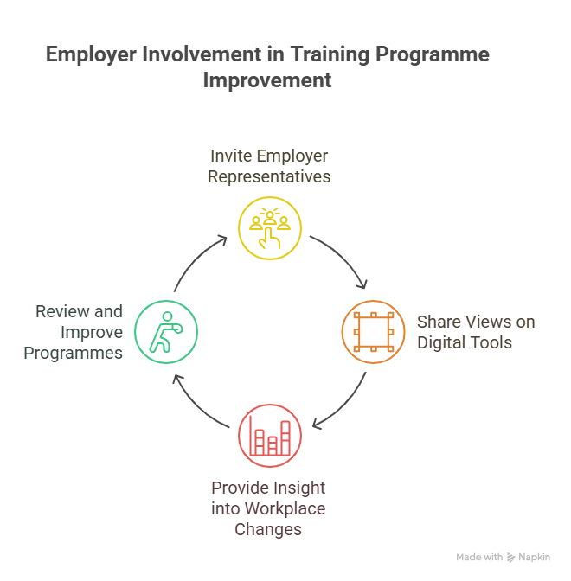
Partnerships Into Learning Opportunities
Strong collaboration offers benefits for both sides. Employers gain graduates who are more prepared for digital tasks, and educators gain access to real examples, tools, and insights that make their teaching more relevant.

Slide 48
1. Think about your current partnerships or contacts with employers. What is one area where closer collaboration could help your institution better align digital training with real workplace needs? Describe what this collaboration could look like and who should be involved. 2. Analyze the Benefits and Challenges. What are the main benefits of building stronger relationships with industry partners? What challenges might you face when starting or maintaining these collaborations, and how could you address them? 3. Based on your reflections, outline one specific action you could take in the next three months to strengthen industry collaboration. What resources or support would you need, and how will you measure success?
Reflexive Activity
Bridging the Green & Digital Divide
Enhance the quality of vocational education and training (VET) in the Western Balkans for sustainable development.

Slide 49







Thank you!
B&P Emerging Technologies

