Slide 1



Digital Skills – 2.2 Digital Technologies for the European Green Deal
Bridging the Green & Digital Divide
Enhance the quality of vocational education and training (VET) in the Western Balkans for sustainable development.

Slide 2


Learning outcomes
Interpret operational data and key performance indicators (KPIs) related to the European Green Deal to identify patterns, outliers, and opportunities for sustainability improvements.
Evaluate and select enabling digital technologies for greener practices based on clear criteria, including purpose, interoperability, and implementation effort.

Slide 3
Course overview
Module 1: Understanding the European green deal
Subtitle 1.1: Key indicators of the green deal and the twin transition
Subtitle 1.2: Data interpretation for sustainability
Module 2: Enabling digital technologies for greener practice
Subtitle 2.1: Case studies of green digital technologies in action
Subtitle 2.2: Criteria for technology selection
Subtitle 1.3: Contextual analysis and sense-checking
Subtitle 2.3: Planning for implementation

Slide 4
Module 1: Understanding the European green deal
Subtitle 1.1: Key indicators of the green deal and the twin transition
Subtitle 1.2: Data interpretation for sustainability
Subtitle 1.3: Contextual analysis and sense-checking
Bridging the Green & Digital Divide
Enhance the quality of vocational education and training (VET) in the Western Balkans for sustainable development.

Slide 5
Subtitle 1.1: Key indicators of the green deal and the twin transition
Key aspects:
Define and understand the key performance indicators (KPIs) relevant to sustainability.
Introduce the concept of the EU's ‘twin transition’ (green and digital) .
Discuss how digital technologies are essential for achieving European Green Deal objectives.
Notes:
Question : do you already have ideas on your abstract subject ?
Prefer meeting before (OCs to brainstorm+each with subjects) or during CM ?

Slide 6

The European Green Deal: A Roadmap for Transformation
Digital transformation has reshaped how organisations collect information, monitor performance, and make decisions.
Technologies such as sensors, automation, and connected devices now play a direct role in how sustainability progress is measured.
Image: eo4society.esa.int
The European Green Deal builds on this digital evolution. Its goal is to create a climate-neutral, resource-efficient, and competitive economy. To understand how well Europe is progressing, the EU tracks key indicators that show whether policies and actions are producing real environmental and social benefits.

Slide 7
What Key Indicators Tell Us
Key Performance Indicators reveal how countries, sectors, and organisations are moving toward sustainability. They include data on emissions, energy use, waste generation, resource efficiency, and renewable energy.
EU Data Governance Act
Digital Europe Programme
Together, these measurements show where progress is happening and where additional action is needed.
ensure that sustainability data is accessible, reliable, and responsibly managed.

Slide 8
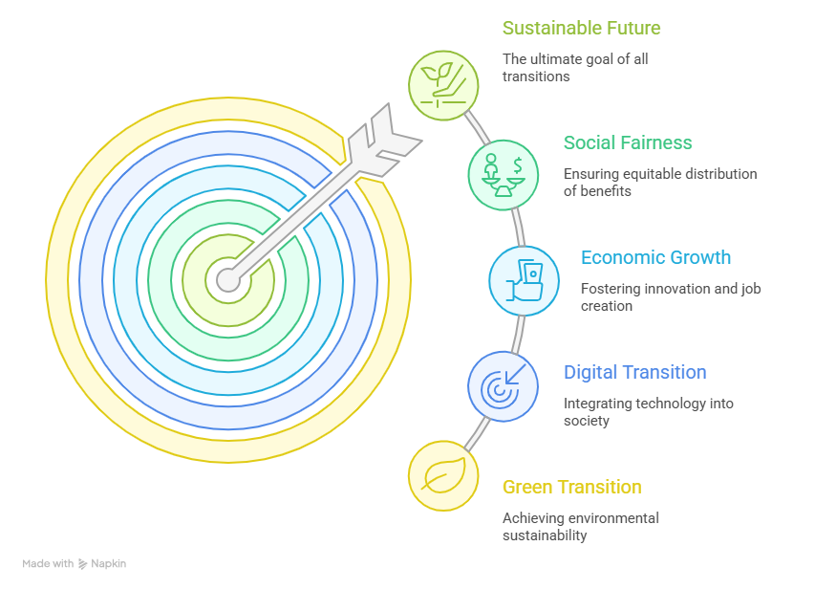
The Twin Transition: Green + Digital Together
The twin transition refers to the integration of green and digital transformation across all sectors. Digital tools support environmental goals by providing fast and accurate information, while sustainability principles guide the development of greener digital systems.
Sensors, dashboards, AI models, and real-time monitoring systems make it possible to understand performance more precisely and act sooner.
At the same time, improving the sustainability of digital systems themselves is becoming an important part of the Green Deal.

Slide 9
Why This Matters for VET and the Labor Market
For VET learners and educators, KPIs are more than technical measurements. They reflect real workplace tasks where workers interpret digital information, identify inefficiencies, and support decisions that improve environmental performance.
As digitalisation expands, many professions now require basic data skills, from reading sensor outputs to understanding simple dashboards.
By learning how indicators work and how digital tools generate them, learners become better prepared for a labour market shaped by both sustainability goals and digital innovation.

Slide 10
Subtitle 1.2: Data Interpretation for Sustainability
Key aspects:
Develop practical skills for reading operational datasets to identify meaningful trends, patterns, and significant outliers that signal risks or opportunities.
Notes:
Question : do you already have ideas on your abstract subject ?
Prefer meeting before (OCs to brainstorm+each with subjects) or during CM ?

Slide 11
Turning data into meaningful insight
Sustainability progress depends on small, measurable changes, and data shows what is really happening in daily operations.
Digitalisation has made this easier by giving even small organisations access to information once limited to large companies.
Interpreting sustainability data means recognising patterns, questioning unusual values, and understanding how digital information reflects real behaviour. This mindset turns raw numbers into insights that guide practical environmental improvements.

Slide 12
Seeing patterns that drive action
When data is tracked over time, it reveals trends that help organisations act with confidence.
A gradual reduction in energy use may reflect effective efficiency measures, while a sudden increase in waste may signal a problem in production or recycling processes.
Digital tools such as dashboards, graphs, and simple datasets make these patterns visible. Learners can practise with basic tables showing energy use, water consumption, or waste totals to build confidence in reading and interpreting sustainability information.

Slide 13
Interpretation is more than reading numbers
A single value does not explain itself. High energy use might reflect poor efficiency, but it could just as easily reflect increased activity. A low emissions value could signal improvement or could come from a faulty sensor or incomplete dataset.
This is why data interpretation requires curiosity and reflection. Learners explore how data was collected, whether it is complete and consistent, and what operational factors may explain the results.
Understanding data quality and common digital errors helps prevent misinterpretations and supports better decisions.

Slide 14
Subtitle 1.3: Contextual Analysis and Sense-Checking
Key aspects:
Learn to apply critical thinking to data by considering the operational context, performing sense-checks, and avoiding common pitfalls of data over-interpretation.
Notes:
Question : do you already have ideas on your abstract subject ?
Prefer meeting before (OCs to brainstorm+each with subjects) or during CM ?

Slide 15

Image:jan.piatkowsk.unspash
Why Context Matters in Sustainability Data
A number only makes sense when we understand the situation behind it. An increase in electricity use may seem negative until we learn that new equipment was installed or more learners were enrolled.
A decrease in water use may look like progress but might simply reflect a temporary shutdown.
Context transforms raw values into meaningful information and prevents misinterpretations that can happen when people rely only on dashboards or automated reports.

Slide 16
Sense-Checking as a Practical Habit
Sense-checking means asking whether a result is realistic. Values that look unusually high or suspiciously low often require a second look.
A month with “zero waste” or a sudden drop in emissions may be the result of incomplete reporting, missing data, sensor malfunction, or gaps in connectivity.
Questioning unexpected values builds trust in digital tools and helps avoid acting on data that is inaccurate or incomplete.

Slide 17
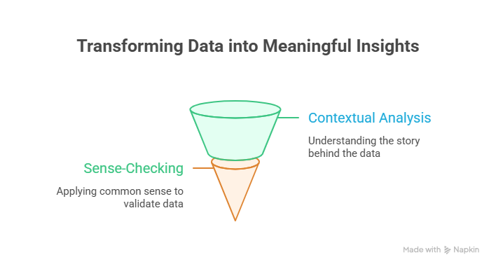
Combining Data with Human Experience
Digital systems provide fast information, but they cannot replace the practical understanding of people who know the daily reality of their workplace.
Staff often notice operational details that explain unusual results, such as maintenance work, equipment downtime, or changes in activity levels.
When digital data is combined with human experience, interpretation becomes more accurate and more useful for decision-making.

Slide 18
Module 2: Enabling digital technologies for greener practice
Subtitle 2.1: Case studies of green digital technologies in action
Subtitle 2.2: Criteria for technology selection
Subtitle 2.3: Planning for implementation
Bridging the Green & Digital Divide
Enhance the quality of vocational education and training (VET) in the Western Balkans for sustainable development.

Slide 19
Subtitle 2.1: Case studies of green digital technologies in action
Key aspects:
Explore real-world examples of how digital tools support sustainability across key VET sectors
Examples of case studies.
Notes:
Question : do you already have ideas on your abstract subject ?
Prefer meeting before (OCs to brainstorm+each with subjects) or during CM ?

Slide 20

Image:planet.volumes.unspash
How Digital Tools Shape Greener Practices
Across Europe, digital technologies are helping organisations reduce waste, save resources, and improve environmental performance.
These tools turn sustainability from an abstract idea into practical action by using sensors, data platforms, and connected systems to monitor what is happening in real time.
When digital information flows smoothly, organisations can make faster decisions and identify opportunities to work more efficiently.
Image by noah-buscher-x8ZStukS2PM-unsplash

Slide 21
Practical Examples Across Sectors
  In agriculture, digital monitoring systems such as soil sensors, weather data tools, and satellite images help farmers apply water or fertiliser only when needed.
  In construction, shared digital models help teams estimate material needs accurately and reduce errors during renovation or new building work.
  In the energy sector, smart grids and digital meters support real-time adjustments that lower consumption and increase system stability.

Slide 22



EU Real Projects
Focused on using BIM to support energy-efficient building renovation (https://www.bim4eeb-project.eu).
The project helped cities like Milan, Lisbon, and London use digital platforms for mobility, energy management, and public services
(https://sharingcities.eu).
Provides an open digital platform that connects different types of farm data and equipment (https://www.atlas-h2020.eu).

Slide 23
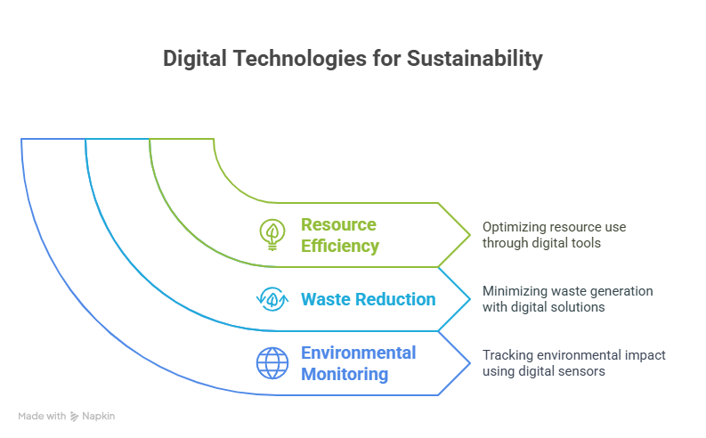
Why These Examples Matter for VET
These examples show learners how digital tools are used in real workplaces to achieve sustainability goals. Seeing sensors, dashboards, and digital platforms in action helps learners understand how their future roles will rely on simple digital skills and environmental awareness.
By connecting digital practice with green outcomes, learners can imagine themselves contributing directly to the European Green Deal in their own professional contexts.
Image by artem-balashevsky-Ld-5Lu-eU6A-unsplash

Slide 24
Subtitle 2.2: Criteria for technology selection
Key aspects:
Define and apply a simple evaluation framework for choosing digital tools based on purpose, ease of use, interoperability, and basic privacy considerations.
Notes:
Question : do you already have ideas on your abstract subject ?
Prefer meeting before (OCs to brainstorm+each with subjects) or during CM ?

Slide 25

Image:franz.grosmann.unspash
Choosing technology with a clear purpose
Selecting a digital tool starts with understanding the specific problem it needs to solve. A tool for tracking energy use serves a different purpose than a system for coordinating teams or sharing data.
When the purpose is clear, it becomes easier to judge whether a technology truly supports sustainability goals or simply adds complexity without value.
A well-defined purpose keeps decisions focused on meaningful improvements rather than on following digital trends.
Image by annie-spratt-a3mXEG8AEx8-unsplash

Slide 26
Tools that fit people, systems, and daily work
A suitable technology must feel intuitive for users and work smoothly with existing systems. When a tool integrates naturally into daily routines, teams adopt it more easily and data flows without interruption. Practical considerations matter as well.
Tools that require heavy maintenance, complex configuration, or specialised expertise often slow progress. The most effective technologies are those that simplify tasks while quietly improving sustainability performance in the background.
This also includes choosing solutions that minimise the environmental footprint of digital systems.
Image by bogdan-karlenko-36b7JBzhfF4-unsplash

Slide 27
Making Responsible and Scalable Choices
A responsible choice considers how data is stored, who can access it, and whether privacy is protected. Technologies should follow European standards for data security and support responsible data use. It is also important to select tools that can grow with the organisation.
A system that works well today should be flexible enough to add new features, connect with other platforms, or support more users in the future.
When tools are chosen with purpose, usability, privacy, and long-term value in mind, organisations can build a digital environment that supports both sustainability and future development.
Image by bogdan-karlenko-36b7JBzhfF4-unsplash

Slide 28
Subtitle 2.3: Planning for implementation
Key aspects:
Assess the practical effort required to implement a chosen technology and formulate a clear justification for its selection based on the evaluation criteria.
Notes:
Question : do you already have ideas on your abstract subject ?
Prefer meeting before (OCs to brainstorm+each with subjects) or during CM ?

Slide 29

Image:katttoh.unspash
Starting with clear intentions
Introducing a new digital tool works best when everyone understands why it is being adopted and what specific improvement it should create.
A clear intention gives direction to the entire process and helps users stay focused on real sustainability outcomes rather than on the technology itself.
When people can see the expected benefits, the transition feels purposeful and achievable.

Slide 30
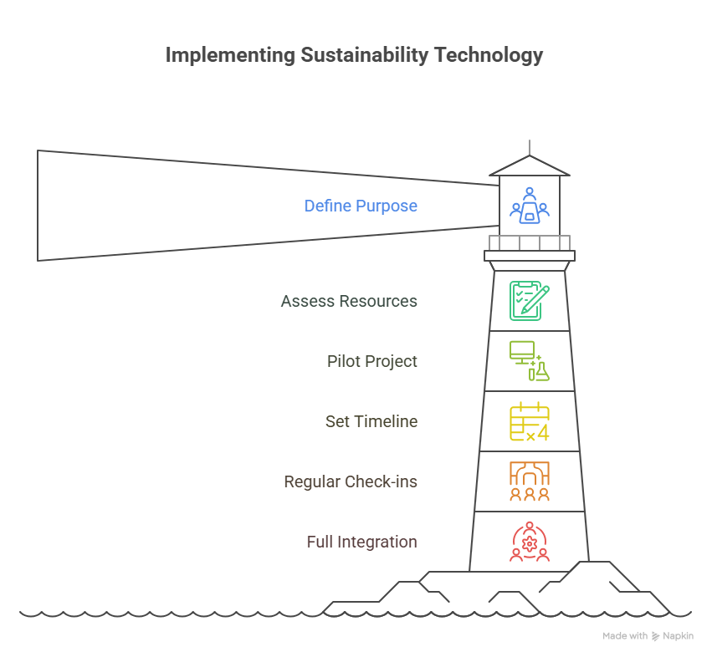
Building confidence through small, guided steps
Implementation becomes smoother when the process begins at a manageable scale.
A short pilot allows teams to test how the tool behaves, notice challenges, and identify the support users need. Short training sessions and open communication help make the new system feel familiar rather than disruptive.
As early results appear, even small ones, users gain confidence and the change becomes a shared effort.

Slide 31
Keeping implementation alive through continuous learning
Once the tool is in place, regular reflection ensures it continues to deliver value. Feedback from users, data reports, and everyday observations help reveal what is working and what needs adjustment.
This creates a learning cycle where the tool becomes stronger over time. For learners, understanding this cycle reinforces the idea that digital technologies succeed when people remain engaged, curious, and ready to adapt.
Implementation is not a single step but an ongoing practice that supports long-term sustainability.

Slide 32
1. Think about your learners and the sectors they will work in. What is one digital skill they may need to strengthen to better support sustainable practices? Describe how this gap affects their ability to engage with digital technologies or sustainability tasks in the workplace.
2. Reflect on what might be preventing your learners from developing this skill. Are the barriers technical, such as lack of access to tools or data? Or do they relate to confidence, time, or teaching resources?
3. Based on your reflections, design a short and realistic plan to help your learners improve this digital skill. What steps will you take to introduce or strengthen it in your teaching? What kind of support or materials would make this plan work smoothly for all learners?
Reflective activity
Bridging the Green & Digital Divide
Enhance the quality of vocational education and training (VET) in the Western Balkans for sustainable development.

Slide 33







Thank you!
B&P Emerging Technologies

