Slide 1



Digital Skills – 2.1 Digital Literacy in the Labour Market
Bridging the Green & Digital Divide
Enhance the quality of vocational education and training (VET) in the Western Balkans for sustainable development.

Slide 2


Learning outcomes
Analyze labour-market signals from job adverts and sector briefings to identify and map digital skills to ESCO descriptors, revealing priority competences and trends.
Differentiate between transversal and sector-specific digital skills, including content creation, data, and AI literacy, to prioritize essential competences for VET provision.
Identify common participation barriers (e.g., connectivity, confidence, disability) and design inclusive, evidence-based mitigation strategies for learning materials and simple dashboards.

Slide 3
Course overview
Module 1: Labour-market signals and ESCO mapping
Subtitle 1.1: Sourcing and interpreting labour-market data
Subtitle 1.2: Extracting and normalizing digital skills terminology
Module 2: Core digital skills across VET-served sectors
Subtitle 2.1: Building foundational digital competences
Subtitle 2.2: The role of AI literacy in VET
Module 3: Barriers and inclusion strategies
Subtitle 3.1: Identifying common barriers to digital learning
Subtitle 3.2: Designing inclusive digital learning materials
Subtitle 1.3: Connecting skills and standards
Subtitle 2.3: Transversal and sector-specific skills
Subtitle 3.3: Creating accessible dashboards and visual aids

Slide 4
Module 1: Labour-market signals and ESCO mapping
Subtitle 1.1: Sourcing and interpreting labour-market data
Subtitle 1.2: Extracting and normalizing digital skills terminology
Subtitle 1.3: Connecting skills and standards
Bridging the Green & Digital Divide
Enhance the quality of vocational education and training (VET) in the Western Balkans for sustainable development.

Slide 5
Subtitle 1.1: Sourcing and implementing labour-market data
Key aspects:
Learn to identify and interpret relevant data sources such as online job adverts, sector-specific reports, and official labour-market briefings.
Notes:
Question : do you already have ideas on your abstract subject ?
Prefer meeting before (OCs to brainstorm+each with subjects) or during CM ?

Slide 6

Image: art_Maltsev.unsplash
Vocational and Educational Training
Vocational education and training (VET) provides learners with essential skills supporting their employability personal development and active participation in the society.
Understanding the labour market is an important step in preparing learners for real jobs. Labour-market data can come from many places (online job adverts, company websites, industry reports, and government employment portals).
By exploring them regularly, it is possible to build a clear picture of trends and skills employers are asking for.

Slide 7
Jobs Adverts as Data Sources
Observing these adverts, give us an understanding of which digital tools are becoming common across different industries.
Digital skills are not only for office jobs, they are present in many professions. Industry and sector reports are another valuable source.
These data help us understand long-term trends, such as the growing importance of data, communication tools, and basic cybersecurity skills.
When VET teachers understand these trends, they can update lessons with popular tools.
Understand the needs in the market
Updated lessons according to the market needs

Slide 8
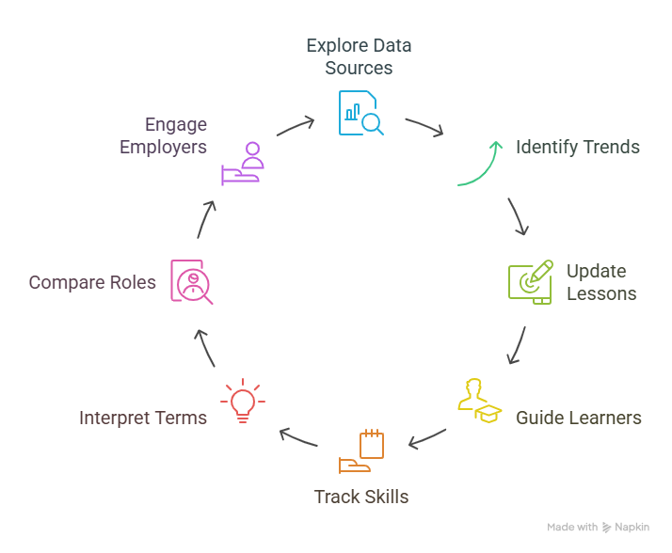
Job Market & Data
As you explore labour-market information, the goal is not to understand everything.
Instead, focus on simple questions:
Which digital tools are becoming standard?
Which competences support the green and digital transition?
Which trends affect my learners’ sector?

Slide 9
Professional contact (email, messages, calls)
Creating and completing online forms and spreadsheets
Examples of basic digital skills and tools.
Calendar and virtual events management
Identifying digital terms
Not all labour-market information looks the same, so interpreting it requires patience and practice.
Some adverts list very specific software, while others only say “basic computer skills.”
Some reports speak about digital transformation without giving practical examples. In these cases, your goal is to translate general terms into real classroom ideas.
It is important to remember that sometimes there are different tools for the same purpose (e.g. Zoom and Teams for video calling.

Slide 10

Developing a Habit of Observation
Remember that labour-market analysis is not a one-time task.
The world of work changes, and digital tools evolve.
By checking labour-market information regularly, even for a few minutes each week, you stay up to date and feel more confident in your teaching decisions.
Over time, you will develop a habit of thinking like a labour-market observer always asking, “What skills do learners need today, and what skills will they need next?”
Image: agefis.unsplash

Slide 11

How to describe digital skills?
In this course, we will build on this foundation by learning how to extract digital-skills terms and connect them to recognized standards.
The European Skills, Competences, Qualifications, and Occupations framework (ESCO) will bring consistency and clarity across teaching.
(https://esco.ec.europa.eu)
Image: iStockphoto

Slide 12
Subtitle 1.2: Extracting and Normalizing Digital Skills Terminology
Key aspects:
Develop techniques to extract key digital skill terms from raw data and standardize them for consistent analysis.
Notes:
Question : do you already have ideas on your abstract subject ?
Prefer meeting before (OCs to brainstorm+each with subjects) or during CM ?

Slide 13
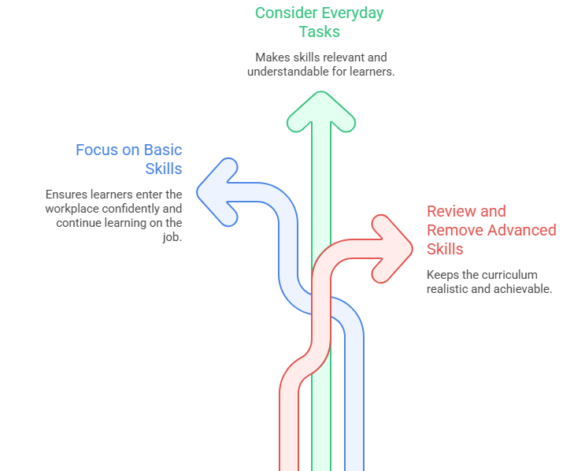
Noticing Digital-Skills Language in Job Adverts
When reviewing job adverts, the first step is to identify the digital skills hidden inside ordinary descriptions of work.
Employers mention tasks such as updating digital records, using booking systems, managing emails, joining online meetings, or working with spreadsheets.
Learning to notice them helps teachers understand how digital tools shape real workplace routines across different sectors.

Slide 14
Creating a Clear List of Skill Terms
As you read different adverts, start collecting key words and phrases.
Some adverts use specific terms (“Excel”, “CRM systems”), while others use broad descriptions (“good digital skills”). Writing these terms in one place allows you to see which skills repeat most often.
For example, “video-call platforms”, “Zoom”, and “Teams meetings” all point to digital communication tools. Normalizing means grouping these variations into a single, simple term that learners can understand.
This reduces confusion and makes it easier to compare skills across sectors, identify core requirements, and design activities that reflect common digital practices. This list becomes a foundation for designing digital activities, helping teachers move from scattered information to a clear, organized understanding of workplace needs.

Slide 15
Focusing on Realistic, Relevant Skills
The goal is not to list every technical term but to identify skills that are realistic for your learners’ level and profession.
Normalised terminology highlights the essential tasks beginners need: sending professional emails, entering data, sharing documents online, or navigating basic platforms.
Over time, this practice helps teachers create training that is practical, focused, and strongly connected to real job demands, preparing learners for the next step: mapping these skills to ESCO.

Slide 16
Subtitle 1.3: Connecting Skills and Standards
Key aspects:
Use the normalized terms to map required skills to the ESCO framework, enabling the identification of key trends and priority competences.
Notes:
Question : do you already have ideas on your abstract subject ?
Prefer meeting before (OCs to brainstorm+each with subjects) or during CM ?

Slide 17
Why Connect Skills to ESCO?
  Once digital skills are extracted and organized, linking them to ESCO gives structure and consistency.
  ESCO provides official names and descriptions for thousands of skills, helping teachers confirm that their terminology matches how skills are recognized across Europe.
  This connection strengthens the credibility of training plans, supports alignment with national strategies, and creates a shared language between teachers, employers, and policymakers.
Image: iStockphoto

Slide 18
Making Sense of ESCO in Practice
Using ESCO does not require technical expertise:
Teachers can search familiar terms such as “spreadsheets”, “digital communication”, or “data entry” to see how each skill is defined and which occupations it supports.
This helps identify which skills are transversal across sectors and which ones are more specific to particular roles.
Seeing skills grouped in this way allows teachers to focus on the areas most relevant for learners' future jobs.

Slide 19
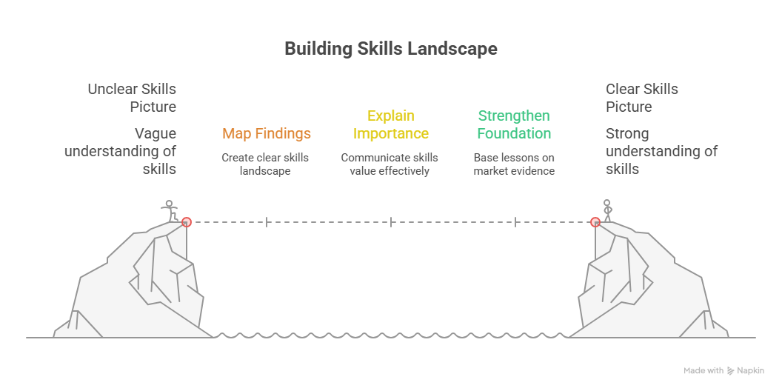
Turning Mapped Skills Into Teaching Priorities
Once skills are mapped to ESCO, teachers can easily identify the skills that appear most often and should form the foundation of digital training.
Sector-specific skills can then be added on top, creating a balanced, realistic learning pathway.
This mapping step ensures that teaching is aligned with workplace expectations and prepares learners effectively for real digital tasks.

Slide 20
Module 2: Core digital skills across VET-served sectors
Subtitle 2.1: Building Foundational Digital Competences
Subtitle 2.2: The Role of AI Literacy in VET
Subtitle 2.3: Transversal and Sector-Specific Skills
Bridging the Green & Digital Divide
Enhance the quality of vocational education and training (VET) in the Western Balkans for sustainable development.

Slide 21
Subtitle 2.1: Building Foundational Digital Competences
Key aspects:
Review the definitions and applications of essential skills, including digital content creation, data literacy, and online communication.
Notes:
Question : do you already have ideas on your abstract subject ?
Prefer meeting before (OCs to brainstorm+each with subjects) or during CM ?

Slide 22
Why Foundational Digital Skills Matter
Foundational digital competences are now essential in almost every profession, not just in office-based roles.
They include everyday tasks like writing emails, searching for information, entering simple data, and using online communication tools.
For VET learners, these skills form the starting point for understanding more complex digital processes, supporting confidence, independence, and readiness for real workplaces.
Image by noah-buscher-x8ZStukS2PM-unsplash

Slide 23
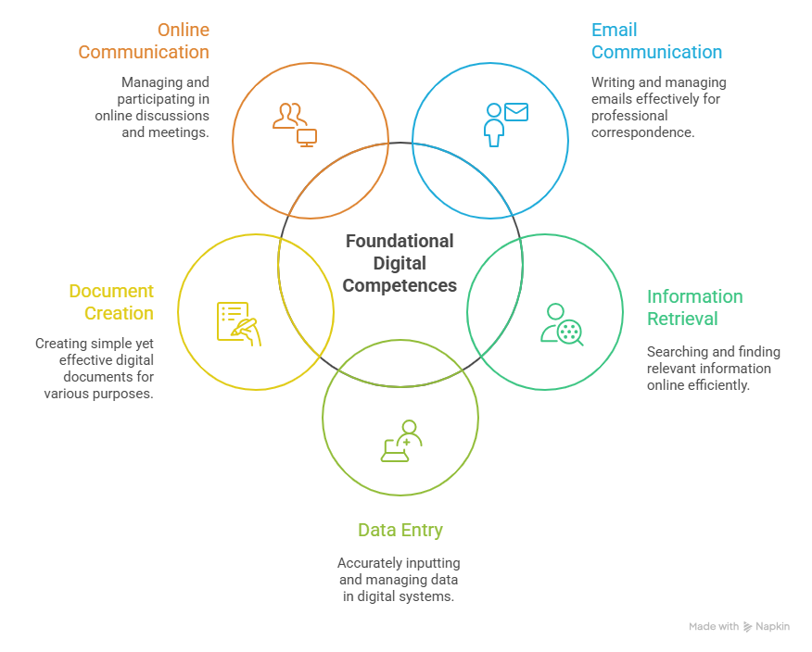
From Personal Use to Professional Practice
  Many learners use digital tools in their personal lives, but workplace expectations are different.
  Professional digital competence involves communicating clearly, storing information safely, collaborating online, and following procedures that support quality and efficiency.
  Helping learners make this shift is a key goal of VET digital training.

Slide 24
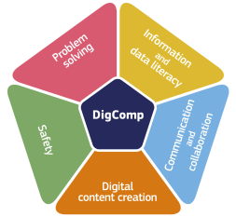
Frameworks That Guide Teaching (DigComp)
The DigComp framework describes five areas of digital competence: information and data literacy, communication and collaboration, content creation, safety, and problem-solving.
Teachers do not need to memorize the full framework; instead, it provides a structure for planning.
Connecting classroom tasks to these areas ensures training covers the essential competences required across many sectors and job roles.
Image: joint-research-centre.ec.europa.eu
Image by artem-balashevsky-Ld-5Lu-eU6A-unsplash

Slide 25
Subtitle 2.2: The Role of AI Literacy in VET
Key aspects:
Understand the practical implications of AI literacy.
Explore case studies on how simple AI tools can be used to solve common problems in VET settings.
Notes:
Question : do you already have ideas on your abstract subject ?
Prefer meeting before (OCs to brainstorm+each with subjects) or during CM ?

Slide 26

Understanding AI as Part of Everyday Work
Image: axelrodsun.unsplash
Artificial intelligence is already present in many ordinary tasks: sorting emails, suggesting products, checking spelling, translating text, or managing schedules.
In workplaces, AI supports planning, quality control, customer service, and data tracking.
For VET learners, AI literacy means recognizing these tools, understanding what they do, and using them confidently as part of their daily routines.

Slide 27

Connecting AI Literacy to Foundational Digital Skills
AI literacy builds on the basics: knowing how data is stored, shared, and used.
Once learners understand data and communication tools, they can better interpret how AI systems make predictions or suggestions.
In VET contexts, this means knowing when to follow an automated recommendation and when human judgment is needed: a practical skill that protects safety, quality, and fairness in the workplace.
Image: getty.images-unsplash

Slide 28
Practical Examples of AI in VET-Sector Jobs
AI tools appear in many vocational areas:
Construction: cameras check safety equipment and count materials.
Hospitality: booking systems adjust prices or predict demand.
Manufacturing: sensors predict machine faults before they happen.
Administration, chatbots answer simple customer queries.
Helping learners explore these examples reduces fear of technology and shows that AI is not coding but using intelligent tools responsibly in real work situations.
Image by bogdan-karlenko-36b7JBzhfF4-unsplash

Slide 29
Subtitle 2.3: Transversal and Sector-Specific Skills
Key aspects:
Practice classifying digital skills to distinguish between universal (transversal) needs and those unique to specific industries or job roles.
Notes:
Question : do you already have ideas on your abstract subject ?
Prefer meeting before (OCs to brainstorm+each with subjects) or during CM ?

Slide 30

Image: kellysikkema.unsplash
Understanding Transversal Skills
Transversal digital skills are used across many different jobs and sectors.
They include tasks such as writing emails, searching for information safely, filling in online forms, using shared documents, and joining video meetings.
Because these skills appear in almost every profession, they give learners flexibility and confidence to adapt as workplace technologies evolve.

Slide 31
Recognizing Sector-Specific Digital Skills
Sector-specific skills reflect the unique digital practices of each profession.
These skills go beyond general tools and relate to specialized processes, equipment, or platforms used in a particular industry.
They help learners understand how digitalization shapes the core tasks of their future roles.
Examples include:
Precision tools for planning and measuring in technical trades
Booking, review, and customer-management systems in service sectors
Digital health records, appointment systems, and monitoring tools in care professions
Inventory, logistics, and tracking software in retail and warehousing
Sector-specific skills show learners what makes their profession digitally distinct and prepare them for technologies they will encounter on workspace.

Slide 32
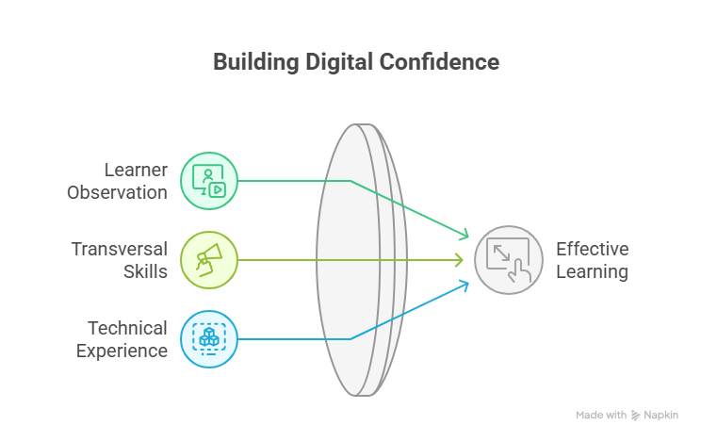
Building a Balanced Digital Learning Path
A strong VET digital curriculum blends transversal foundations with sector-specific tools.
Transversal competences prepare learners to handle any digital environment, while specific tools give them a clear professional identity.
Using scenarios, workplace examples, and simple simulations helps learners understand how the two levels connect; building confidence, adaptability, and readiness for modern work.
Images by VOLVO website and remy-lovesy-hn9PnGuVy9s-unsplash

Slide 33
Module 3: Barriers and inclusion strategies
Subtitle 3.1: Identifying Common Barriers to Digital Learning
Subtitle 3.2: Designing Inclusive Digital Learning Materials
Subtitle 3.3: Creating Accessible Dashboards and Visual Aids
Bridging the Green & Digital Divide
Enhance the quality of vocational education and training (VET) in the Western Balkans for sustainable development.

Slide 34
Subtitle 3.1: Identifying Common Barriers to Digital Learning
Key aspects:
Explore and categorize potential barriers to participation, including technical issues (connectivity), personal factors (confidence), and accessibility challenges.
Notes:
Question : do you already have ideas on your abstract subject ?
Prefer meeting before (OCs to brainstorm+each with subjects) or during CM ?

Slide 35

Image: arifriyanto.unsplash
Understanding Why Barriers Appear
Digital learning offers many opportunities, but not all learners start with the same confidence or access.
Some face practical challenges like slow internet or outdated devices, while others struggle with motivation, fear of making mistakes, or limited experience with digital tools.
Recognizing these different starting points helps teachers understand why some learners progress quickly while others need more support to feel comfortable in digital environments.
Image by alvaro-reyes-qWwpHwip31M-unsplash

Slide 36
Types of Barriers That Affect Learners
Barriers show up in different ways and often overlap.
Technical barriers include unstable internet, shared devices at home, or platforms that require too many steps.
Personal barriers include low confidence, worry about failure, or past negative experiences with technology.
Accessibility barriers arise when materials are not designed for learners with visual, hearing, language, or reading difficulties.
Understanding these categories helps teachers identify where support is needed and adjust activities so every learner can participate.
Image by olav-ahrens-rotne-4Ennrbj1svk-unsplash

Slide 37
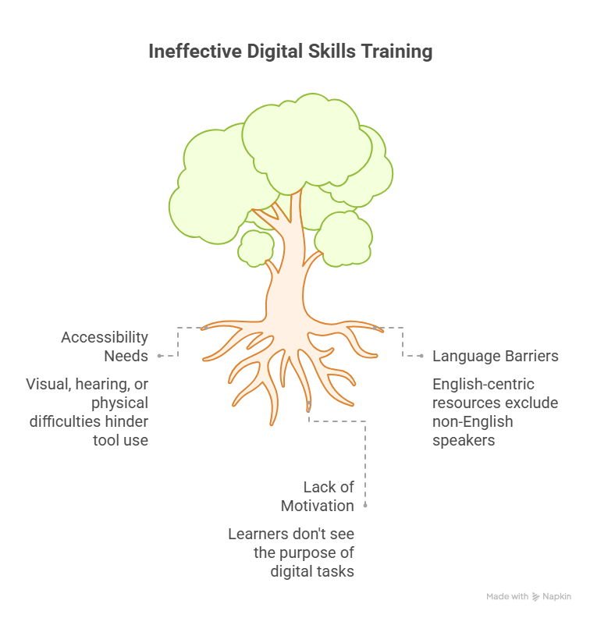
Why Identifying Barriers Matters for Teaching
When teachers understand the barriers learners face, they can design learning experiences that are realistic, inclusive, and supportive.
Small adjustments (clearer instructions, alternative formats, step-by-step tasks, or simpler tools) often remove much of the pressure learners feel.
Identifying barriers early also helps prevent frustration, builds trust, and ensures that digital skills become achievable for everyone, not just confident users.
Image by ux-indonesia-qC2n6RQU4Vw-unsplash

Slide 38
Subtitle 3.2: Designing Inclusive Digital Learning Materials
Key aspects:
Apply universal design principles using freely available or standard office software.
Built-in accessibility checkers, creating subtitled videos with online tools, and structuring documents for screen readers to create engaging content for learners with diverse needs.
Notes:
Question : do you already have ideas on your abstract subject ?
Prefer meeting before (OCs to brainstorm+each with subjects) or during CM ?

Slide 39

What Inclusive Digital Materials Aim to Achieve
Inclusive digital materials make learning accessible for every student, regardless of confidence, language level, or previous digital experience.
The goal is not to simplify the content but to remove unnecessary obstacles.
When instructions are clear, layouts are easy to follow, and examples are practical, learners spend less time struggling with the format and more time engaging with the actual learning task.
Image: monajain.unsplash

Slide 40

Key Principles for Inclusive Design
  Effective inclusive design focuses on clarity, structure, and usability.
  Materials work best when they use plain language, short sections, and consistent layouts that guide learners step by step.
  Visuals, icons, and captions can support understanding, but only when they serve a clear purpose.
  Accessibility features, like readable fonts, subtitles, or alternative text, ensure that learners with different needs can participate fully, whether they work on a phone, tablet, or computer.
Image: priscilladupreez.unsplash

Slide 41
Making Digital Tasks Manageable for All Learners
  Digital activities become more inclusive when teachers reduce complexity and make navigation predictable.
  Providing direct links, simple instructions, and repeatable practice tasks helps learners feel more in control.
  Offering materials in different formats (text, video, audio, or printable versions) gives learners a choice in how they learn.
  When learners experience success early, their confidence grows and the digital environment becomes a supportive space rather than a barrier.

Slide 42
Subtitle 3.3: Creating Accessible Dashboards and Visual Aids
Key aspects:
Learn to develop simple, clear dashboards and visualizations using common spreadsheet programs that effectively communicate information while remaining accessible to all users.
Notes:
Question : do you already have ideas on your abstract subject ?
Prefer meeting before (OCs to brainstorm+each with subjects) or during CM ?

Slide 43

Why Dashboards Support Digital Learning
  Dashboards turn information into something visual, simple, and easy to understand.
  For learners, they show progress, priorities, or results at a glance: helping them stay motivated and aware of what they are achieving.
  For teachers, dashboards make it easier to notice patterns, identify who needs extra support, and communicate expectations clearly.
  The goal is not complex design but clarity: a dashboard should help learners understand information quickly and confidently.
Image: majortomagency.unsplash

Slide 44
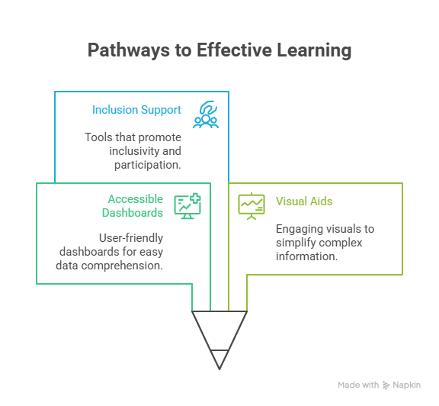
Designing Dashboards That Everyone Can Use
  An effective dashboard focuses on readability and accessibility.
  Clear headings, simple layouts, and high-contrast colors help all learners follow the information without confusion.
  Icons, labels, and short explanations ensure that meaning does not depend on color alone.
  A good dashboard includes only the most important indicators: too much information on one screen can overwhelm learners, while a focused display supports understanding.

Slide 45

Using Visual Aids as Learning Tools
  Visual aids such as charts, diagrams, and icons help make abstract ideas concrete and reduce language barriers.
  When learners co-create dashboards or simple visuals, such as attendance trackers, task progress charts, or digital checklists, they practice real digital tasks that reflect workplace communication.
  Sharing visuals regularly builds transparency, encourages reflection, and helps learners take ownership of their learning journey.
  In this way, visual tools become part of the learning process itself.
Image: kaffie.unsplash

Slide 46
Reflective activity
  1. Think about your learners and the sectors they will work in. What is one digital skill you believe they currently lack, but that is increasingly needed in the labour market? Describe the situation and how this gap affects learners’ readiness for work.
  2. Consider the barriers that might prevent your learners from developing this skill. Are these technical (lack of devices or internet), personal (low confidence), or institutional (limited time or resources)? What opportunities do you see for addressing these barriers within your teaching or training environment?
  3. Based on your reflections, outline a small but practical plan to help your learners build this digital skill. What steps will you take? What resources or support might you need? Try to include at least one inclusive practice to make your plan accessible to all learners.
Bridging the Green & Digital Divide
Enhance the quality of vocational education and training (VET) in the Western Balkans for sustainable development.

Slide 47







Thank you!
B&P Emerging Technologies

